Slide 1
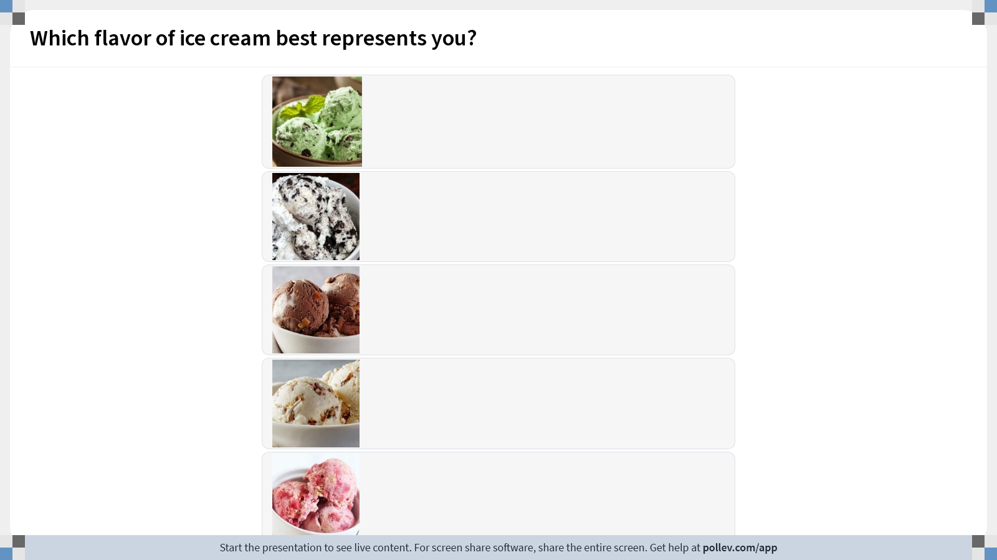
Notes:
Do not modify the notes in this section to avoid tampering with the Poll Everywhere activity. More info at polleverywhere.com/support Which flavor of ice cream best represents you?
https://www.polleverywhere.com/multiple_choice_polls/ethnCcOBD0FrPF2UQfU48?display_state=instructions&activity_state=opened&state=opened&flow=Engagement&onscreen=persist

Slide 2
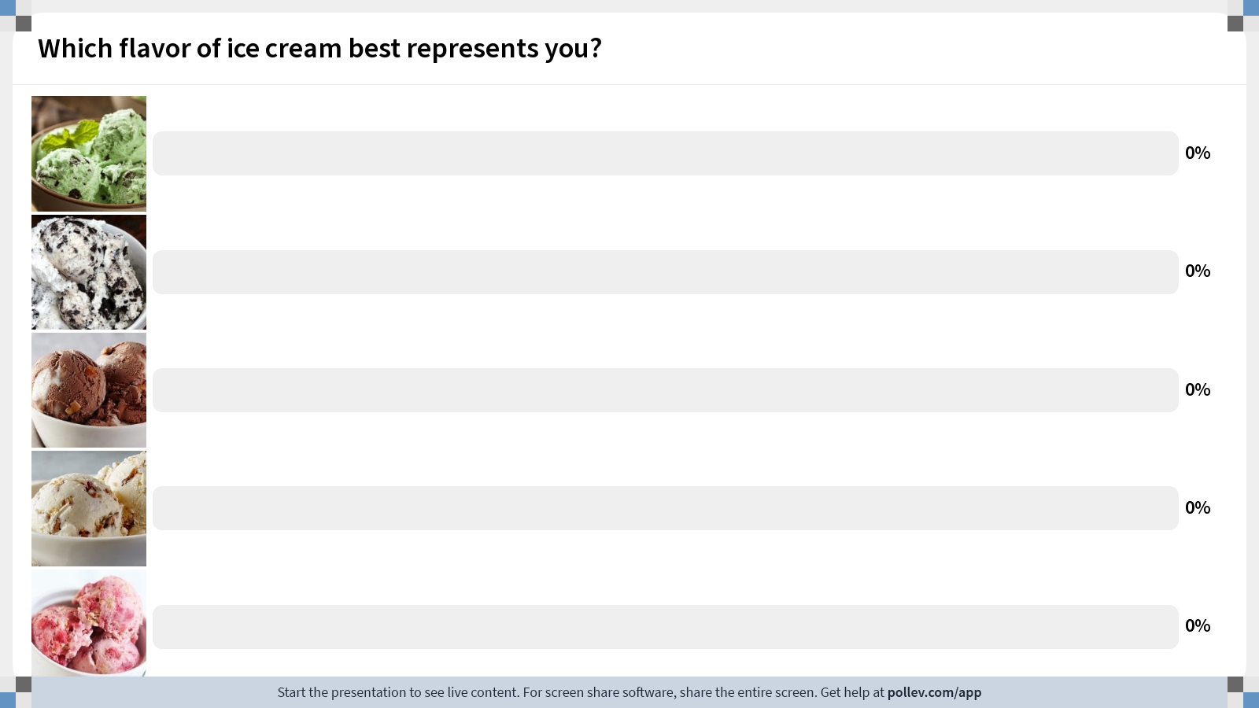
Notes:
Do not modify the notes in this section to avoid tampering with the Poll Everywhere activity. More info at polleverywhere.com/support Which flavor of ice cream best represents you?
https://www.polleverywhere.com/multiple_choice_polls/ethnCcOBD0FrPF2UQfU48?display_state=chart&activity_state=opened&state=opened&flow=Engagement&onscreen=persist

Slide 3
Notes:
Do not modify the notes in this section to avoid tampering with the Poll Everywhere activity. More info at polleverywhere.com/support Which flavor of ice cream best represents you?
https://www.polleverywhere.com/multiple_choice_polls/ethnCcOBD0FrPF2UQfU48?display_state=chart&activity_state=closed&state=closed&flow=Engagement&onscreen=persist

Slide 4
Fundamentals of Ecology
Week 7, Ecology Lecture 4
Cara Brook
February 15, 2024

Slide 5
Let’s recap a bit!

Slide 6
Let’s recap a bit!
Metapopulations
The term ‘metapopulation’ refers to a ‘population of populations’ that can be modeled using Levins’ patch model that describes rates of colonization and extinction for patches of habitat.
The ‘rescue effect’ described by Ilkka Hanski highlights how the probability of extinction for a subpopulation is diminished when it can be recolonized by the larger metapopulation.
Source-sink theory describes how some subpopulations within a metapopulation act as ‘sources’ where births outpace deaths, while others act as ‘sinks’ where deaths outpace births.
The term ‘ecological trap’ describes a species’ preference for poor quality habitat. When sinks outnumber sources, metapopulation dynamics can actually drive a population to extinction as individuals flock to these traps.

Slide 7
Let’s recap a bit!
Metapopulations
The term ‘metapopulation’ refers to a ‘population of populations’ that can be modeled using Levins’ patch model that describes rates of colonization and extinction for patches of habitat.
The ‘rescue effect’ described by Ilkka Hanski highlights how the probability of extinction for a subpopulation is diminished when it can be recolonized by the larger metapopulation.
Source-sink theory describes how some subpopulations within a metapopulation act as ‘sources’ where births outpace deaths, while others act as ‘sinks’ where deaths outpace births.
The term ‘ecological trap’ describes a species’ preference for poor quality habitat. When sinks outnumber sources, metapopulation dynamics can actually drive a population to extinction as individuals flock to these traps.

Slide 8
Let’s recap a bit!
Metapopulations
The term ‘metapopulation’ refers to a ‘population of populations’ that can be modeled using Levins’ patch model that describes rates of colonization and extinction for patches of habitat.
The ‘rescue effect’ described by Ilkka Hanski highlights how the probability of extinction for a subpopulation is diminished when it can be recolonized by the larger metapopulation.
Source-sink theory describes how some subpopulations within a metapopulation act as ‘sources’ where births outpace deaths, while others act as ‘sinks’ where deaths outpace births.
The term ‘ecological trap’ describes a species’ preference for poor quality habitat. When sinks outnumber sources, metapopulation dynamics can actually drive a population to extinction as individuals flock to these traps.

Slide 9
Let’s recap a bit!
Metapopulations
The term ‘metapopulation’ refers to a ‘population of populations’ that can be modeled using Levins’ patch model that describes rates of colonization and extinction for patches of habitat.
The ‘rescue effect’ described by Ilkka Hanski highlights how the probability of extinction for a subpopulation is diminished when it can be recolonized by the larger metapopulation.
Source-sink theory describes how some subpopulations within a metapopulation act as ‘sources’ where births outpace deaths, while others act as ‘sinks’ where deaths outpace births.
The term ‘ecological trap’ describes a species’ preference for poor quality habitat. When sinks outnumber sources, metapopulation dynamics can actually drive a population to extinction as individuals flock to these traps.

Slide 10
Let’s recap a bit!
Interspecies interactions
A community is the level of ecological organization in which multiple species interact: mutualism, commensalism, predation, competition (direct & indirect), and parasitism
Trophic levels are hierarchical levels of organization in an ecosystem, based on nutritional relationships to the source of energy (primary producer, primary consumer)
Food chains and food webs demonstrate interactions across trophic levels
Bottom-up processes describe circumstances when a higher trophic level is limited by the availability of resources provided from a trophic level below it.
Top-down processes describe circumstances in which a higher trophic level regulates a lower trophic level, usually through consumption. First described in HSS.
The Lotka-Volterra predator-prey model describes the simplest interactions across just two trophic levels. It has been used to describe dynamics in several famous examples (lynx-hare, wolf-moose) though it often oversimplifies interspecies interactions
Trophic cascades occur when species indirectly interact across 3 trophic levels. We discussed several famous examples: Pisaster, CA sea otter, Yellowstone wolf, wildebeest

Slide 11
Let’s recap a bit!
Interspecies interactions
A community is the level of ecological organization in which multiple species interact: mutualism, commensalism, predation, competition (direct & indirect), and parasitism
Trophic levels are hierarchical levels of organization in an ecosystem, based on nutritional relationships to the source of energy (primary producer, primary consumer)
Food chains and food webs demonstrate interactions across trophic levels
Bottom-up processes describe circumstances when a higher trophic level is limited by the availability of resources provided from a trophic level below it.
Top-down processes describe circumstances in which a higher trophic level regulates a lower trophic level, usually through consumption. First described in HSS.
The Lotka-Volterra predator-prey model describes the simplest interactions across just two trophic levels. It has been used to describe dynamics in several famous examples (lynx-hare, wolf-moose) though it often oversimplifies interspecies interactions
Trophic cascades occur when species indirectly interact across 3 trophic levels. We discussed several famous examples: Pisaster, CA sea otter, Yellowstone wolf, wildebeest

Slide 12
Let’s recap a bit!
Interspecies interactions
A community is the level of ecological organization in which multiple species interact: mutualism, commensalism, predation, competition (direct & indirect), and parasitism
Trophic levels are hierarchical levels of organization in an ecosystem, based on nutritional relationships to the source of energy (primary producer, primary consumer)
Food chains and food webs demonstrate interactions across trophic levels
Bottom-up processes describe circumstances when a higher trophic level is limited by the availability of resources provided from a trophic level below it.
Top-down processes describe circumstances in which a higher trophic level regulates a lower trophic level, usually through consumption. First described in HSS.
The Lotka-Volterra predator-prey model describes the simplest interactions across just two trophic levels. It has been used to describe dynamics in several famous examples (lynx-hare, wolf-moose) though it often oversimplifies interspecies interactions
Trophic cascades occur when species indirectly interact across 3 trophic levels. We discussed several famous examples: Pisaster, CA sea otter, Yellowstone wolf, wildebeest

Slide 13
Let’s recap a bit!
Interspecies interactions
A community is the level of ecological organization in which multiple species interact: mutualism, commensalism, predation, competition (direct & indirect), and parasitism
Trophic levels are hierarchical levels of organization in an ecosystem, based on nutritional relationships to the source of energy (primary producer, primary consumer)
Food chains and food webs demonstrate interactions across trophic levels
Bottom-up processes describe circumstances when a higher trophic level is limited by the availability of resources provided from a trophic level below it.
Top-down processes describe circumstances in which a higher trophic level regulates a lower trophic level, usually through consumption. First described in HSS.
The Lotka-Volterra predator-prey model describes the simplest interactions across just two trophic levels. It has been used to describe dynamics in several famous examples (lynx-hare, wolf-moose) though it often oversimplifies interspecies interactions
Trophic cascades occur when species indirectly interact across 3 trophic levels. We discussed several famous examples: Pisaster, CA sea otter, Yellowstone wolf, wildebeest

Slide 14
Let’s recap a bit!
Interspecies interactions
A community is the level of ecological organization in which multiple species interact: mutualism, commensalism, predation, competition (direct & indirect), and parasitism
Trophic levels are hierarchical levels of organization in an ecosystem, based on nutritional relationships to the source of energy (primary producer, primary consumer)
Food chains and food webs demonstrate interactions across trophic levels
Bottom-up processes describe circumstances when a higher trophic level is limited by the availability of resources provided from a trophic level below it.
Top-down processes describe circumstances in which a higher trophic level regulates a lower trophic level, usually through consumption. First described in HSS.
The Lotka-Volterra predator-prey model describes the simplest interactions across just two trophic levels. It has been used to describe dynamics in several famous examples (lynx-hare, wolf-moose) though it often oversimplifies interspecies interactions
Trophic cascades occur when species indirectly interact across 3 trophic levels. We discussed several famous examples: Pisaster, CA sea otter, Yellowstone wolf, wildebeest

Slide 15
Let’s recap a bit!
Interspecies interactions
A community is the level of ecological organization in which multiple species interact: mutualism, commensalism, predation, competition (direct & indirect), and parasitism
Trophic levels are hierarchical levels of organization in an ecosystem, based on nutritional relationships to the source of energy (primary producer, primary consumer)
Food chains and food webs demonstrate interactions across trophic levels
Bottom-up processes describe circumstances when a higher trophic level is limited by the availability of resources provided from a trophic level below it.
Top-down processes describe circumstances in which a higher trophic level regulates a lower trophic level, usually through consumption. First described in HSS.
The Lotka-Volterra predator-prey model describes the simplest interactions across just two trophic levels. It has been used to describe dynamics in several famous examples (lynx-hare, wolf-moose) though it often oversimplifies interspecies interactions
Trophic cascades occur when species indirectly interact across 3 trophic levels. We discussed several famous examples: Pisaster, CA sea otter, Yellowstone wolf, wildebeest

Slide 16
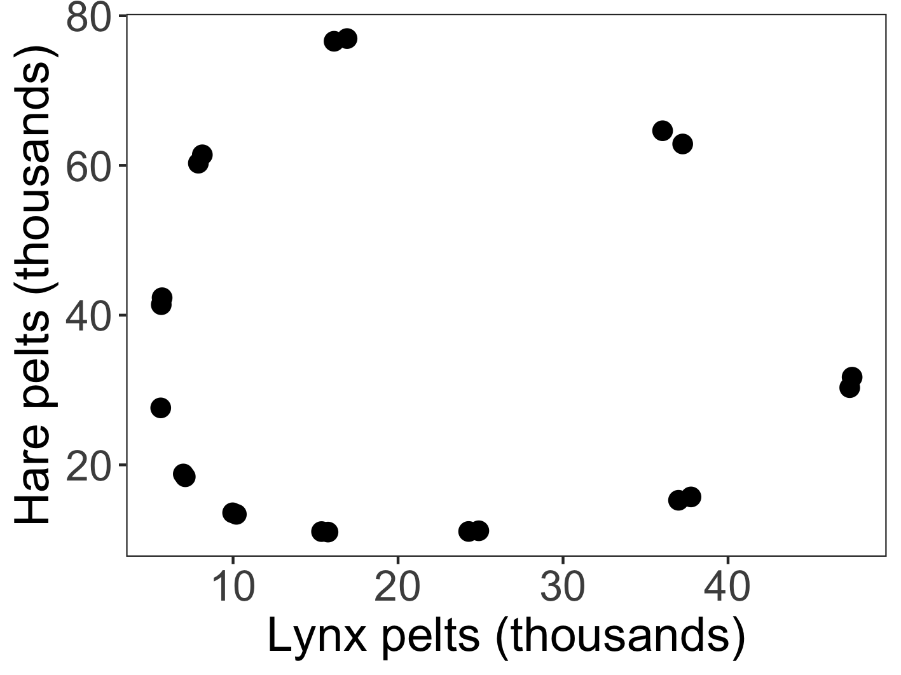


Lotka-Volterra predator-prey models with data
$$\frac{dx}{dt}=αx −βxy$$
Predator-prey cycles can be visualized as oscillations.
hare
(x)
$$\frac{dy}{dt}=δxy −γy$$
lynx
(y)
How does hare abundance vary with changes in lynx abundance?

Slide 17
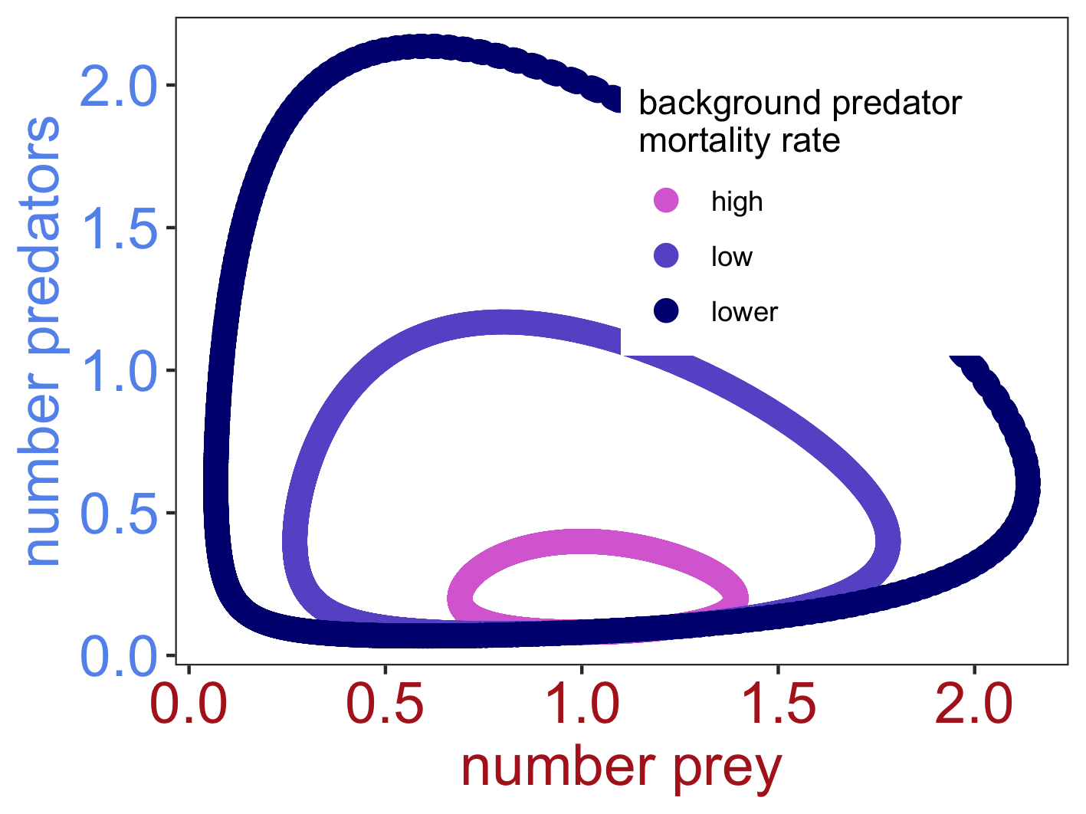
Lotka-Volterra predator-prey models with data
$$\frac{dx}{dt}=αx −βxy$$
Predator-prey cycles can be visualized as oscillations.
hare
(x)
$$\frac{dy}{dt}=δxy −γy$$
lynx
(y)
How does hare abundance vary with changes in lynx abundance?
Notes:
For 2024, explain these phase planes as trajectories of the system, when the RATE of change for each species is not changing. In the case of predator-prey, the rate of change of both species is never changing, as they go up and down and just cycle.

Slide 18
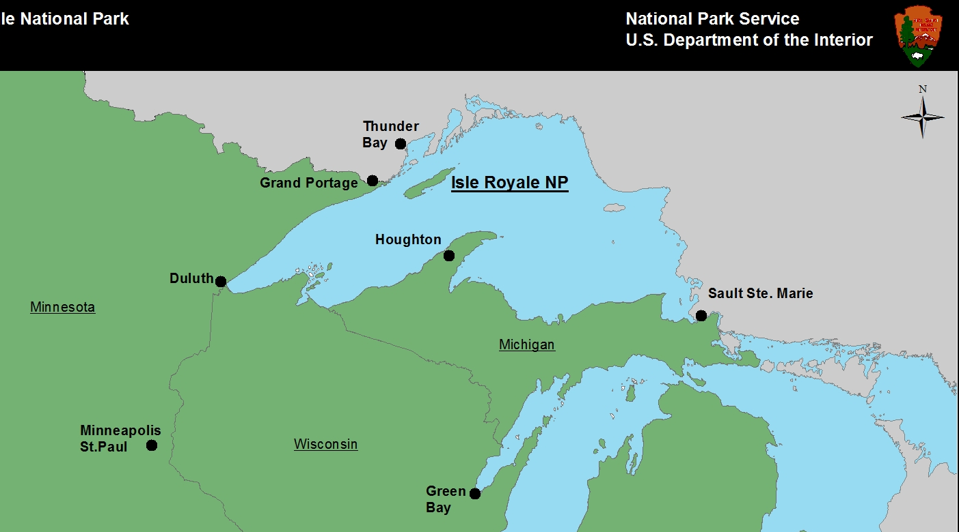
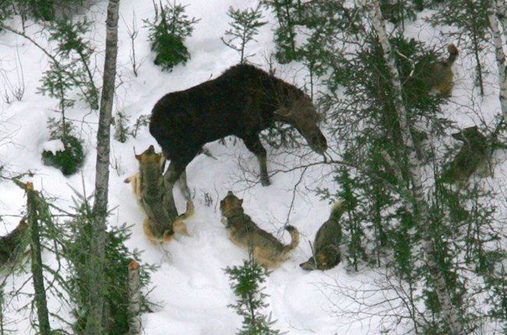
Another famous example: Wolf-Moose on Isle Royale
moose
(x)
isleroyalewolf.org
wolf
(y)
How does moose abundance vary with changes in wolf abundance?

Slide 19
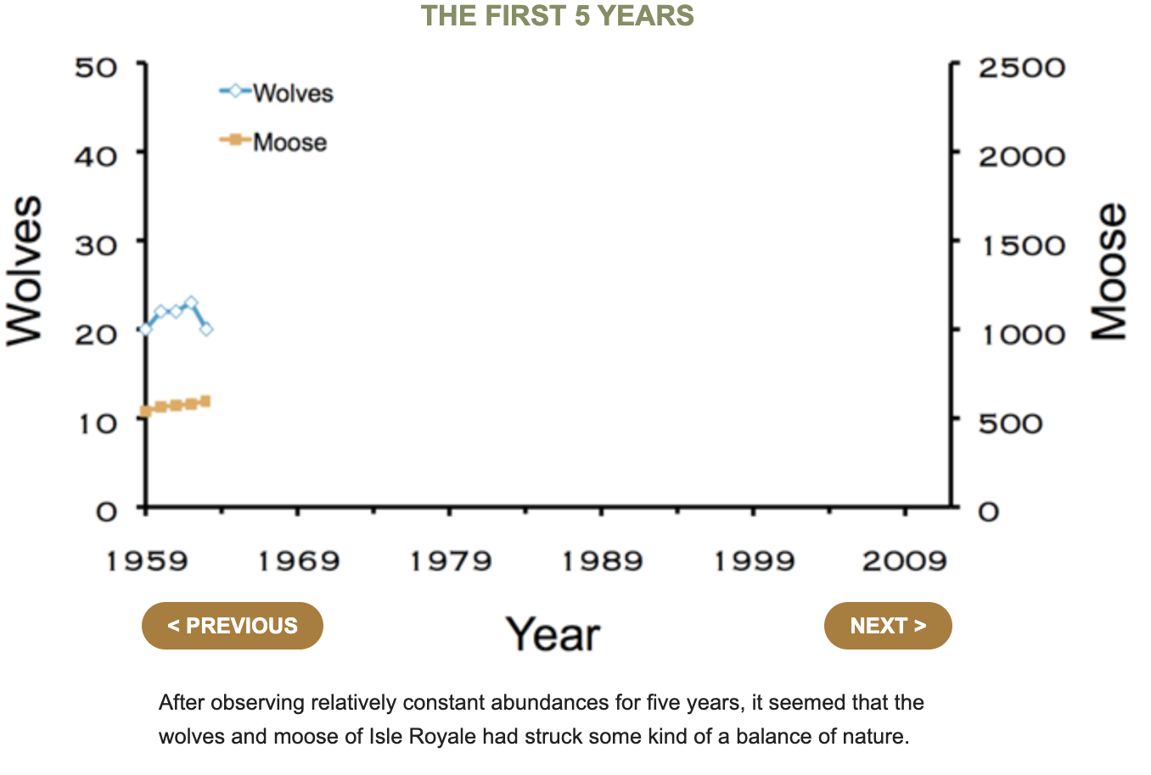
Another famous example: Wolf-Moose on Isle Royale
moose
(x)
wolf
(y)
How does moose abundance vary with changes in wolf abundance?
isleroyalewolf.org

Slide 20
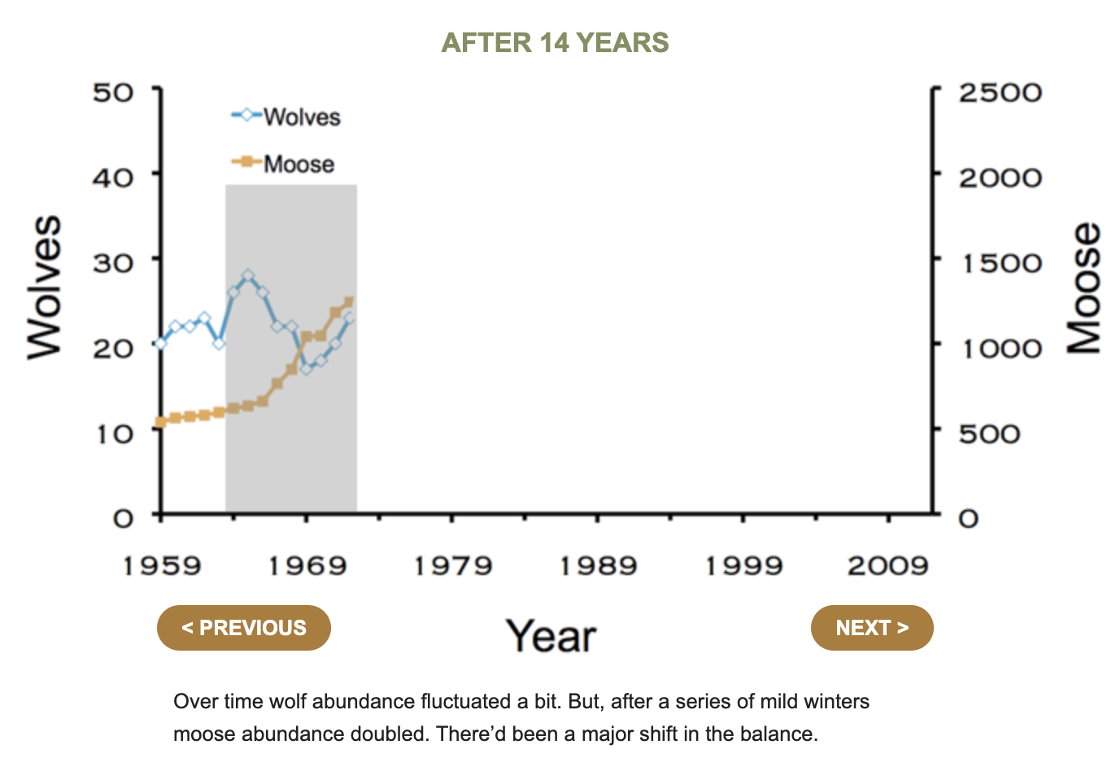
Another famous example: Wolf-Moose on Isle Royale
moose
(x)
wolf
(y)
How does moose abundance vary with changes in wolf abundance?
isleroyalewolf.org

Slide 21
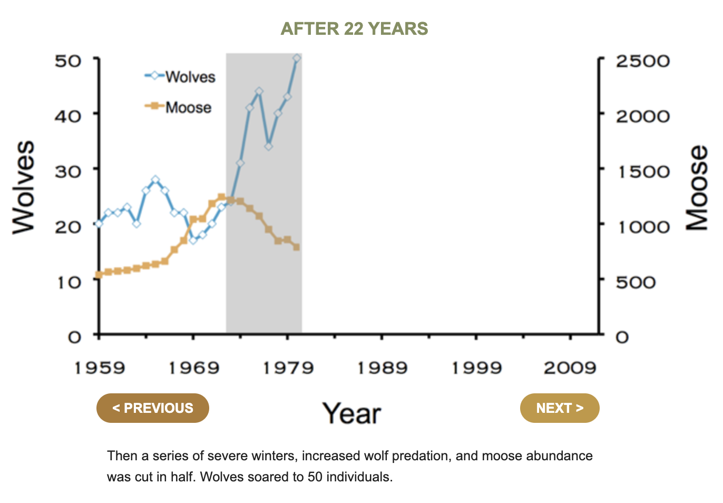
Another famous example: Wolf-Moose on Isle Royale
moose
(x)
wolf
(y)
How does moose abundance vary with changes in wolf abundance?
isleroyalewolf.org

Slide 22
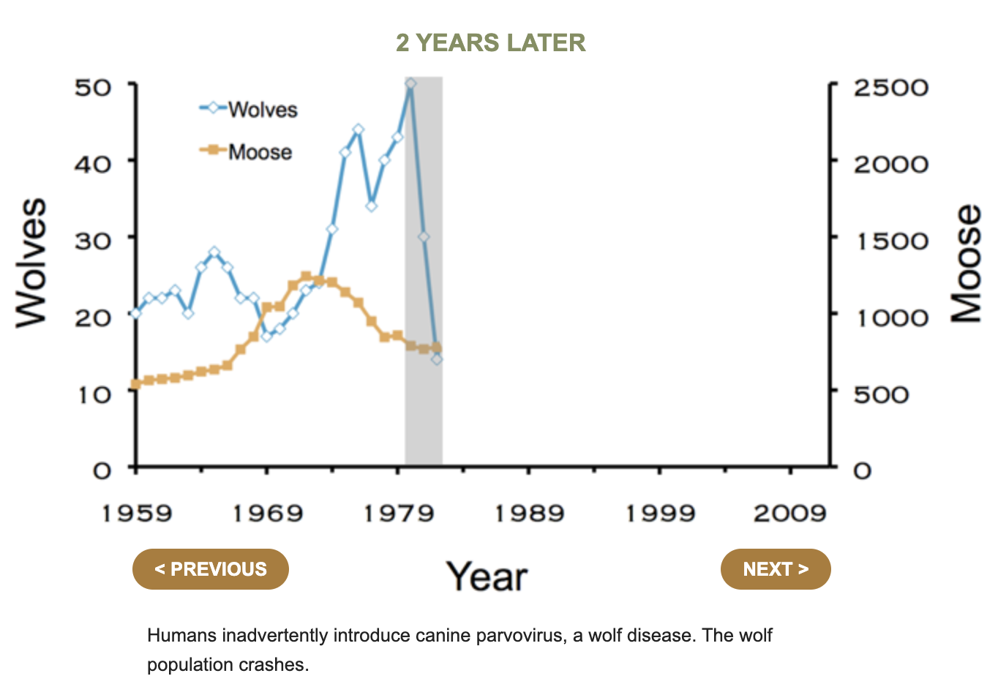
Another famous example: Wolf-Moose on Isle Royale
moose
(x)
wolf
(y)
How does moose abundance vary with changes in wolf abundance?
isleroyalewolf.org

Slide 23
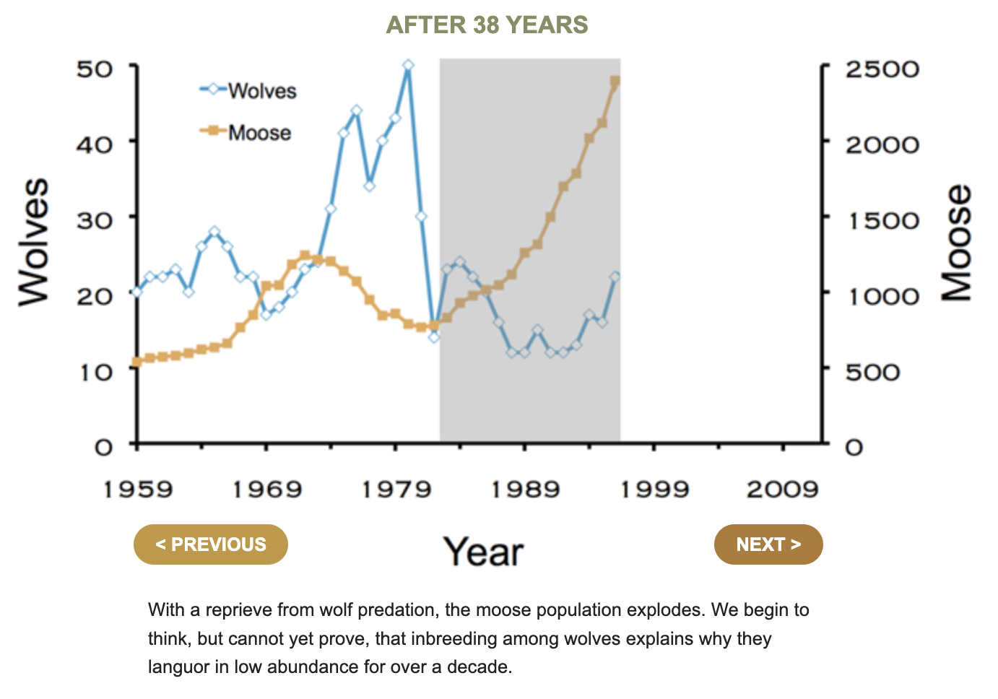
Another famous example: Wolf-Moose on Isle Royale
moose
(x)
wolf
(y)
How does moose abundance vary with changes in wolf abundance?
isleroyalewolf.org

Slide 24
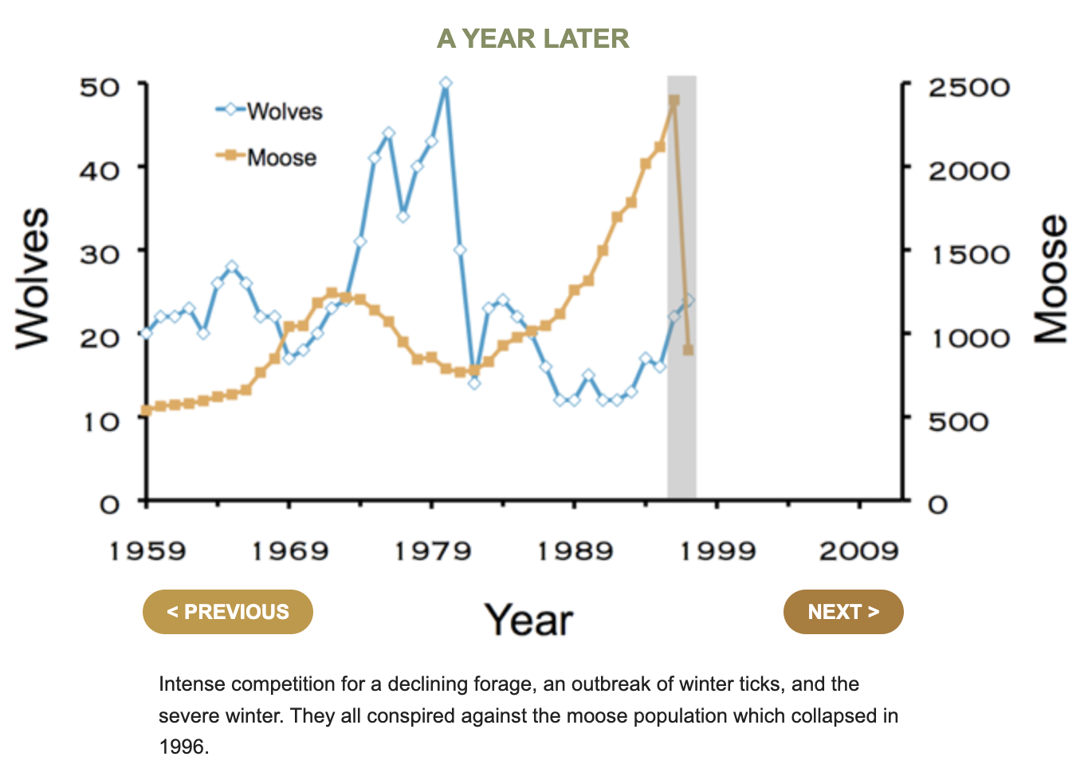
Another famous example: Wolf-Moose on Isle Royale
moose
(x)
wolf
(y)
How does moose abundance vary with changes in wolf abundance?
isleroyalewolf.org

Slide 25
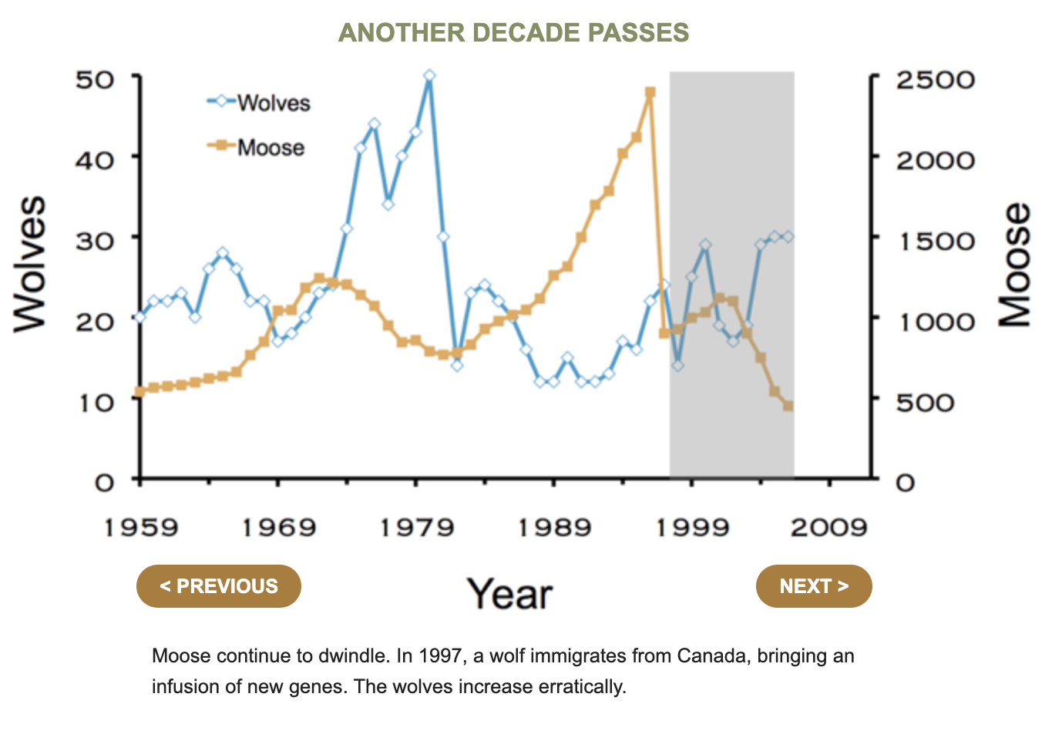
Another famous example: Wolf-Moose on Isle Royale
moose
(x)
wolf
(y)
How does moose abundance vary with changes in wolf abundance?
isleroyalewolf.org

Slide 26
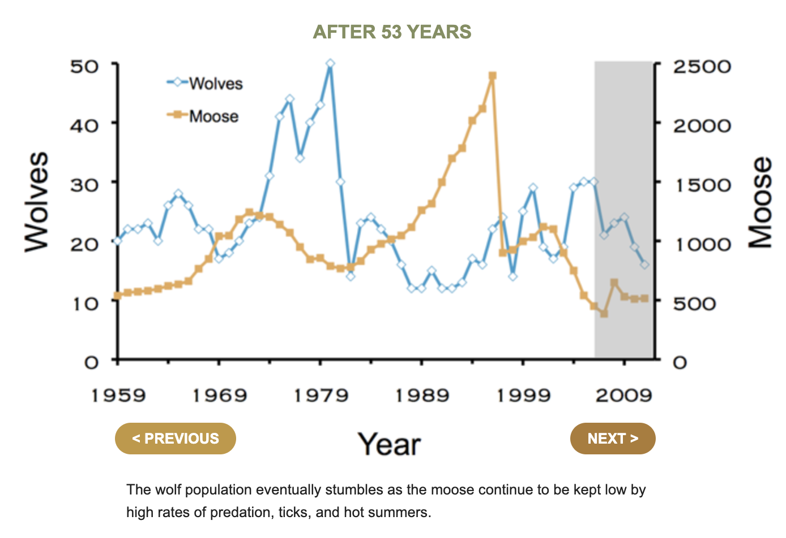
Another famous example: Wolf-Moose on Isle Royale
moose
(x)
wolf
(y)
How does moose abundance vary with changes in wolf abundance?
isleroyalewolf.org

Slide 27

Another famous example: Wolf-Moose on Isle Royale
This could be you!
moose
(x)
wolf
(y)
How does moose abundance vary with changes in wolf abundance?
isleroyalewolf.org

Slide 28
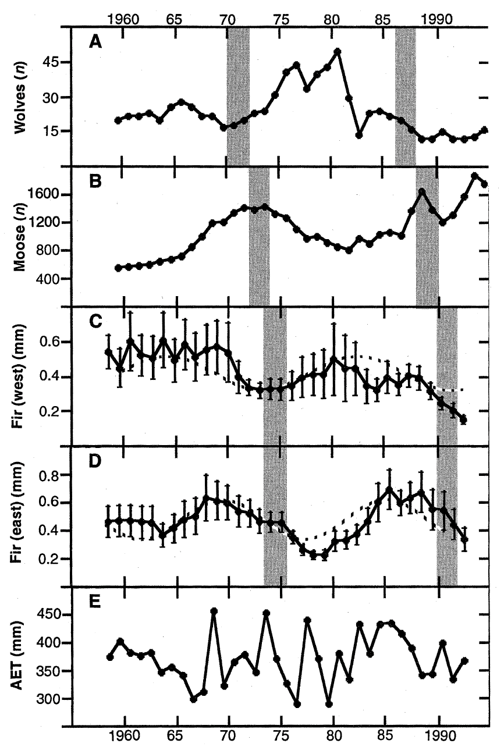
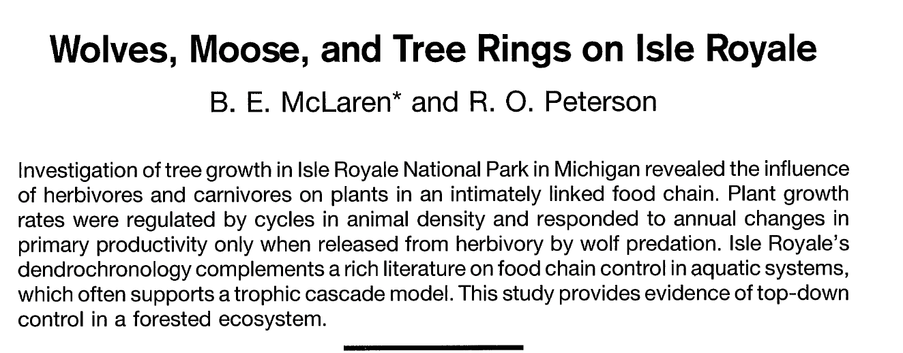
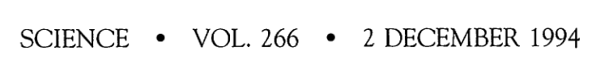
Another famous example: Wolf-Moose on Isle Royale
moose
(x)
Wolf-moose dynamics on Isle Royale are more complex than simple predator-prey.
This 3-way interaction is an example of a trophic cascade.
Trophic cascades occur when indirect effects result in impacts on a third trophic level from one not immediately adjacent.
wolf
(y)
How does moose abundance vary with changes in wolf abundance?

Slide 29
Another famous example: Wolf-Moose on Isle Royale
moose
(x)
Wolf-moose dynamics on Isle Royale are more complex than simple predator-prey.
This 3-way interaction is an example of a trophic cascade.
Trophic cascades occur when indirect effects result in impacts on a third trophic level from one not immediately adjacent.
wolf
(y)
How does moose abundance vary with changes in wolf abundance?

Slide 30
Another famous example: Wolf-Moose on Isle Royale
moose
(x)
Wolf-moose dynamics on Isle Royale are more complex than simple predator-prey.
This 3-way interaction is an example of a trophic cascade.
By, definition, trophic cascades span at least 3 trophic levels, highlighting the process of top-down ecosystem control.
wolf
(y)
How does moose abundance vary with changes in wolf abundance?

Slide 31
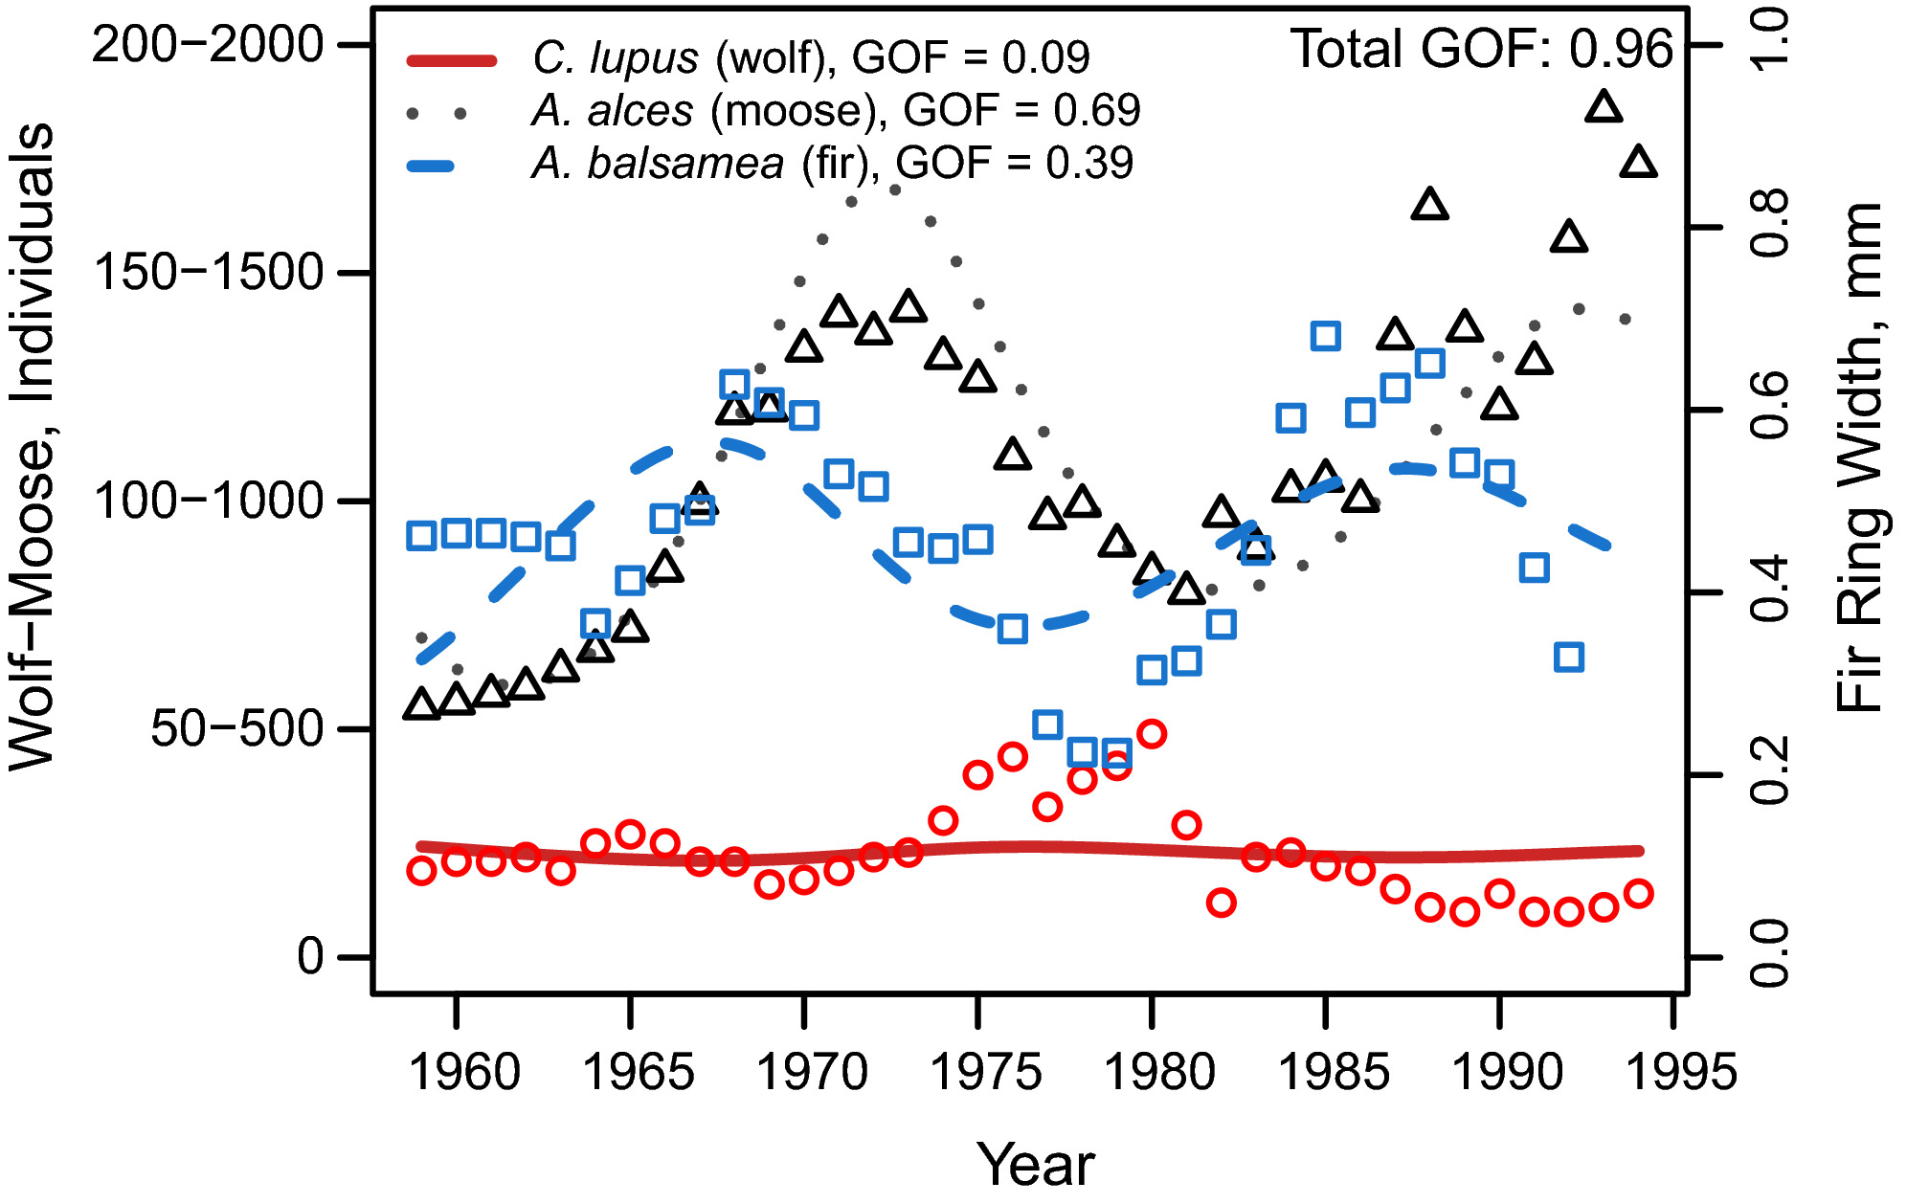

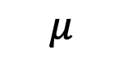
Another famous example: Wolf-Moose on Isle Royale
$$ε$$
fir
$$μ$$
Models incorporating >2 trophic levels can be challenging, but ecologists do sometimes attempt them!
moose
wolf
How does fir growth vary with moose abundance, which varies with changes in wolf abundance?
How fir growth vary with moose abundance, which varies with changes in wolf abundance?
Mülhbauer et al. 2020. Ecology & Evolution.

Slide 32
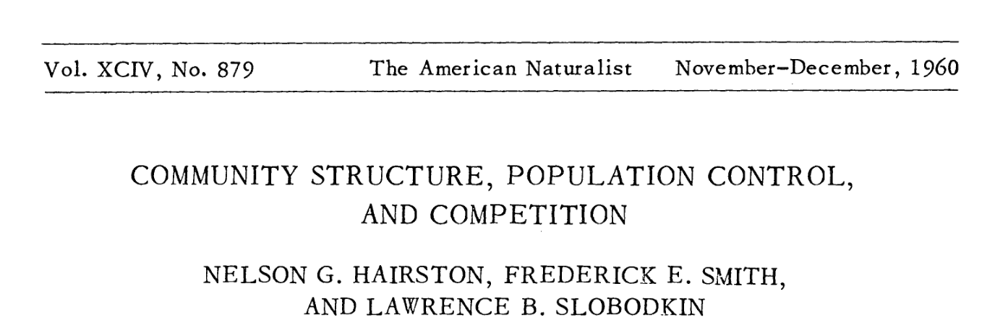
HSS: The first theory of top-down regulation of trophic levels
Producers, decomposers, and carnivores are bottom-up controlled in a density-dependent fashion
Interspecific competition mediates these interactions
Herbivores are top-down controlled (because the ‘the world is green’)
Notes:
In one of the most famous empirical experiments in ecology, Paine removed the dominant predator, Pisaster from the intertidal ecosystem in Tatoosh Island, WA, In the absence of a predator’s top-down control. the ecosystem lost diversity

Slide 33
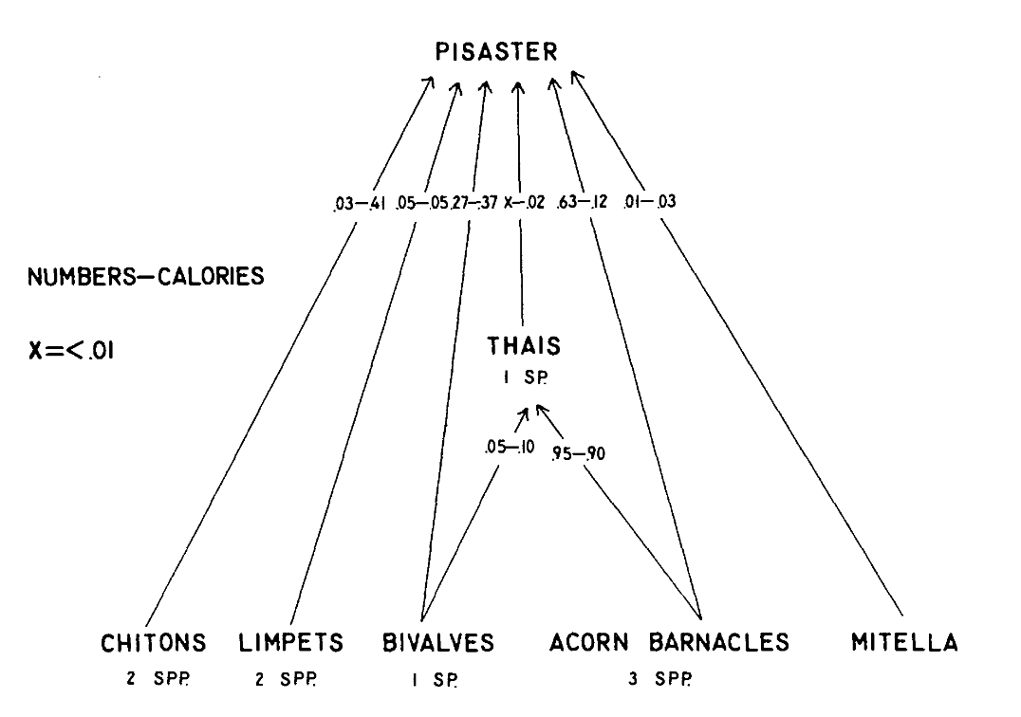
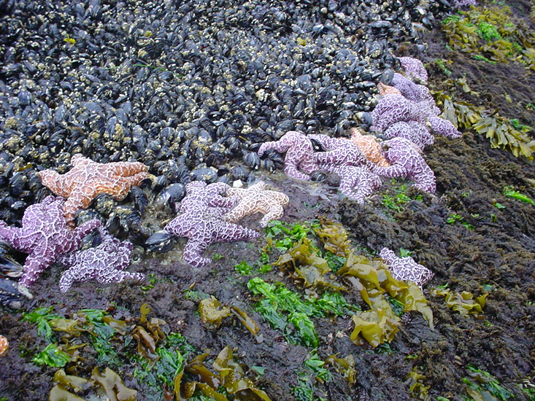
This work inspired empirical studies on trophic cascades:
Pisaster removal on Tatoosh Island
Paine 1966. The American Naturalist.
Notes:
In one of the most famous empirical experiments in ecology, Paine removed the dominant predator, Pisaster from the intertidal ecosystem in Tatoosh Island, WA, In the absence of a predator’s top-down control. the ecosystem lost diversity

Slide 34
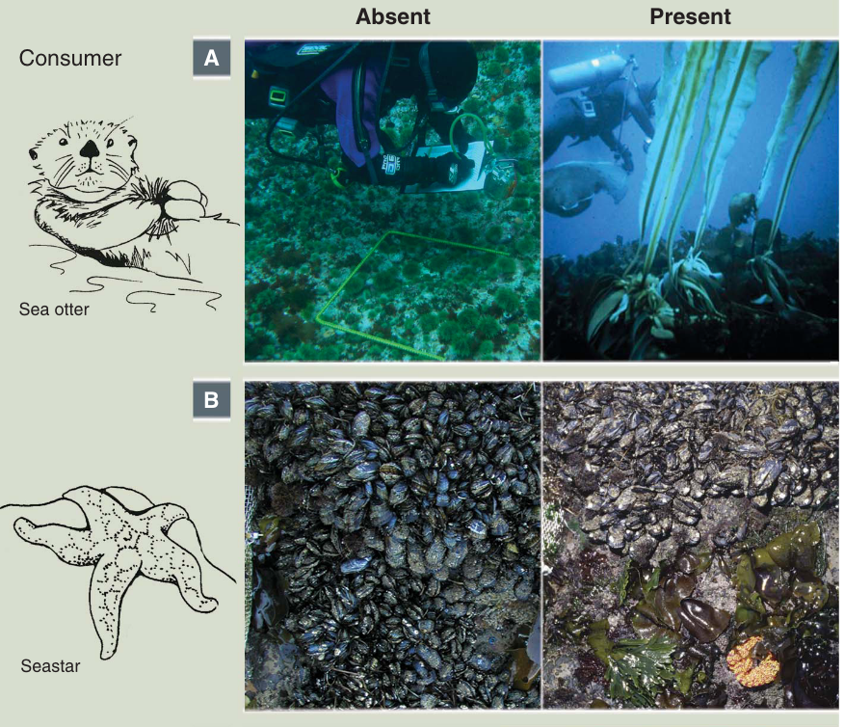
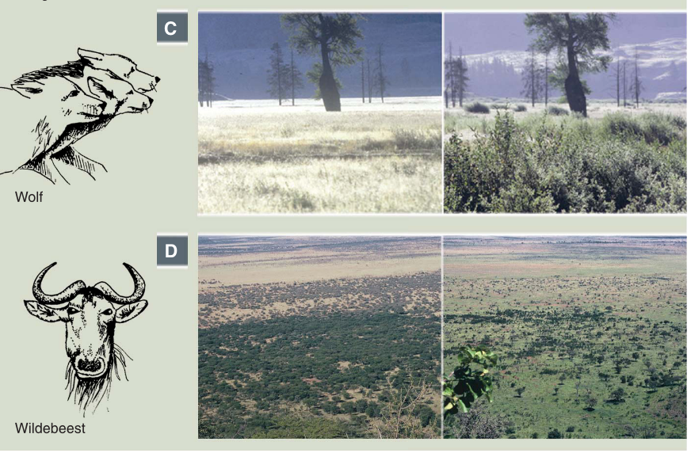
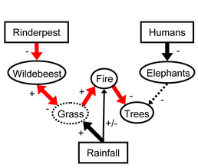
Other famous trophic cascades:
Estes et al. 2011. Science.
CA sea otters maintain kelp forest diversity by consuming herbivorous sea urchins. (Estes & Duggins 1995. Ecological Monographs)
Starfish maintain diversity in Pacific intertidal by consuming space-dominating mussels. (Paine 1966 The American Naturalist)
Yellowstone wolves promote willow recovery by consuming overbrowsing elk (Ripple & Beschta 2005. Forest Ecology & Management)
Rinderpest eradication releases wildebeest populations that control savanna, limit fire, and promote tree regrowth (Holdo et al. 2009. PLoS Biology)
Notes:
In one of the most famous empirical experiments in ecology, Paine removed the dominant predator, Pisaster from the intertidal ecosystem in Tatoosh Island, WA, In the absence of a predator’s top-down control, the ecosystem

Slide 35
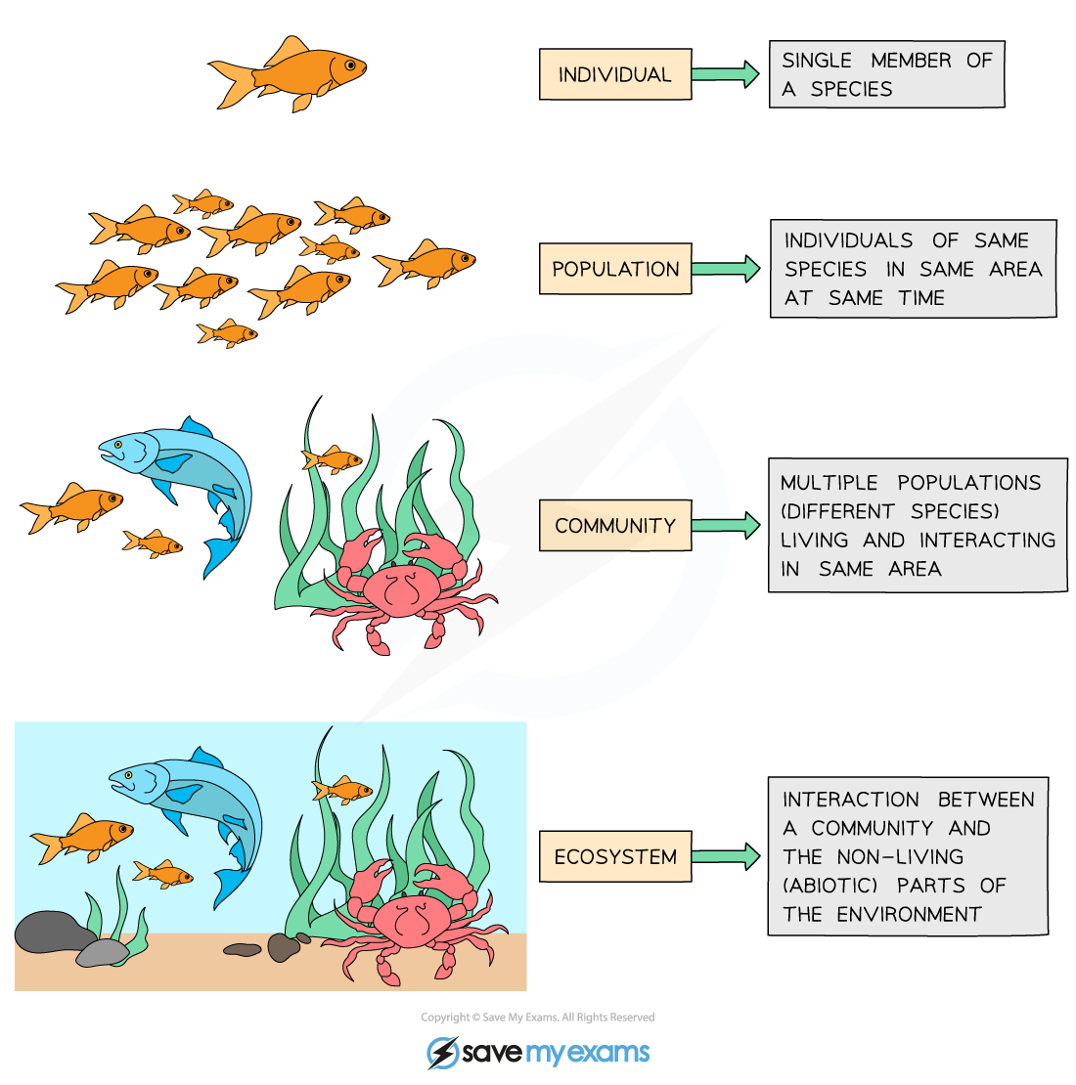
Community = interacting populations of different species
individual
population
fish
(x)
metapopulation
shark
(y)
community
How does fish abundance vary with changes in shark abundance?
ecosystem

Slide 36
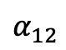
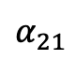
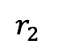
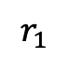
Community = interacting populations of different species
individual
population
$$α_{12}$$
$$r_{1}$$
metapopulation
Fish A
(x₁)
Fish B
(x₂)
$$r_{2}$$
community
$$α_{21}$$
How does the abundance of fish species A vary with changes in the abundance of fish species B?
ecosystem

Slide 37
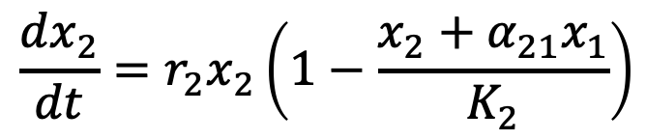
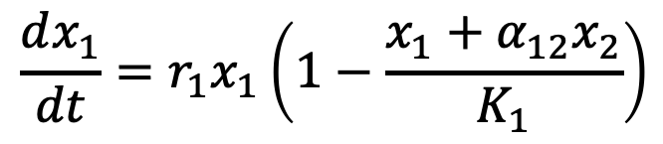
Lotka-Volterra equation can be modified for interspecies competition.
$$\frac{dx_{1}}{dt}={r_{1}x}_{1}\left(1−\frac{x_{1}+α_{12}x_{2}}{K_{1}}\right)$$
$$\frac{dx_{2}}{dt}={r_{2}x}_{2}\left(1−\frac{x_{2}+α_{21}x_{1}}{K_{2}}\right)$$

Slide 38
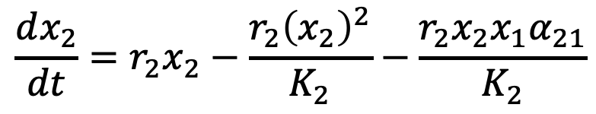
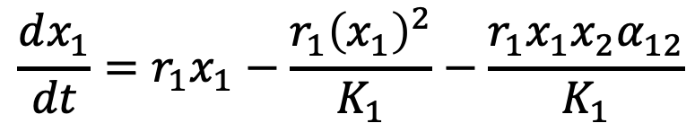
Lotka-Volterra equation can be modified for interspecies competition.
$$\frac{dx_{1}}{dt}={r_{1}x}_{1}−\frac{r_{1}{\left(x_{1}\right)}^{2}}{K_{1}}−\frac{r_{1}x_{1}x_{2}α_{12}}{K_{1}}$$
$$\frac{dx_{2}}{dt}={r_{2}x}_{2}−\frac{r_{2}{\left(x_{2}\right)}^{2}}{K_{2}}−\frac{r_{2}x_{2}x_{1}α_{21}}{K_{2}}$$

Slide 39
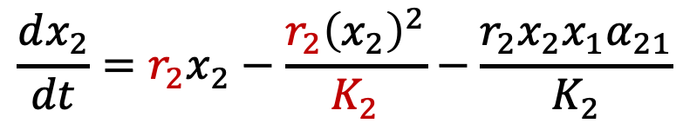
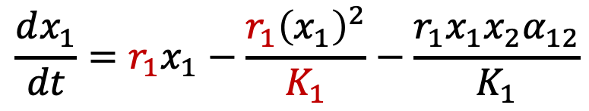
Lotka-Volterra equation can be modified for interspecies competition.
intraspecies competition of species 1 (akin to logistic growth)
Each species is self-regulated by logistic growth and its own carrying capacity (K) and growth rate (r).
But also regulated by the density of its competitor (e.g. for a specific resource).
$$\frac{dx_{1}}{dt}={r_{1}x}_{1}−\frac{r_{1}{\left(x_{1}\right)}^{2}}{K_{1}}−\frac{r_{1}x_{1}x_{2}α_{12}}{K_{1}}$$
$$\frac{dx_{2}}{dt}={r_{2}x}_{2}−\frac{r_{2}{\left(x_{2}\right)}^{2}}{K_{2}}−\frac{r_{2}x_{2}x_{1}α_{21}}{K_{2}}$$
intraspecies competition of species 2

Slide 40
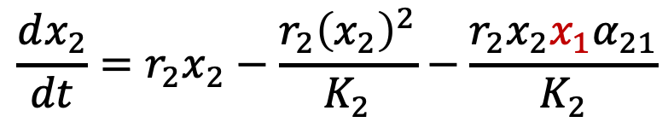
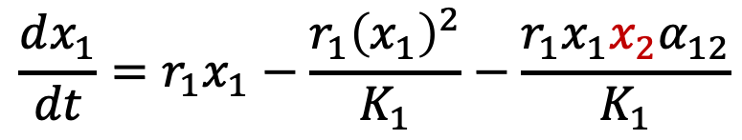
Lotka-Volterra equation can be modified for interspecies competition.
intraspecies competition of species 1 (akin to logistic growth)
interspecies competition with species 2
Each species is self- regulated by logistic growth and its own carrying capacity (K) and growth rate (r).
Each species is also regulated by the density of its competitor (e.g. for a specific resource).
$$\frac{dx_{1}}{dt}={r_{1}x}_{1}−\frac{r_{1}{\left(x_{1}\right)}^{2}}{K_{1}}−\frac{r_{1}x_{1}x_{2}α_{12}}{K_{1}}$$
$$\frac{dx_{2}}{dt}={r_{2}x}_{2}−\frac{r_{2}{\left(x_{2}\right)}^{2}}{K_{2}}−\frac{r_{2}x_{2}x_{1}α_{21}}{K_{2}}$$
intraspecies competition of species 2
interspecies competition with species 1

Slide 41
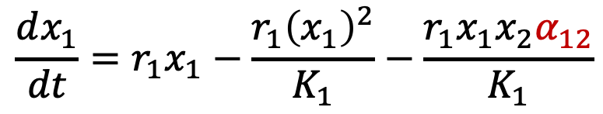
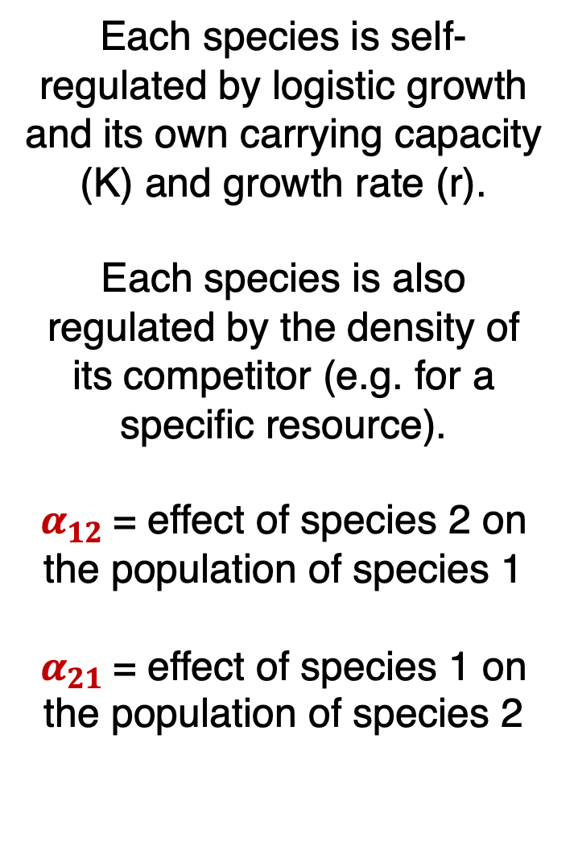

Lotka-Volterra equation can be modified for interspecies competition.
intraspecies competition of species 1 (akin to logistic growth)
interspecies competition with species 2
Each species is self- regulated by logistic growth and its own carrying capacity (K) and growth rate (r).
Each species is also regulated by the density of its competitor (e.g. for a specific resource).
$α_{12}$= effect of species 2 on the population of species 1
$α_{21}$= effect of species 1 on the population of species 2
$$\frac{dx_{1}}{dt}={r_{1}x}_{1}−\frac{r_{1}{\left(x_{1}\right)}^{2}}{K_{1}}−\frac{r_{1}x_{1}x_{2}α_{12}}{K_{1}}$$
$$\frac{dx_{2}}{dt}={r_{2}x}_{2}−\frac{r_{2}{\left(x_{2}\right)}^{2}}{K_{2}}−\frac{r_{2}x_{2}x_{1}α_{21}}{K_{2}}$$
intraspecies competition of species 2
interspecies competition with species 1

Slide 42
The 2-species Lotka-Volterra competition model has four equilibria.
Remember: equilibrium occurs when neither population is changing!

Slide 43
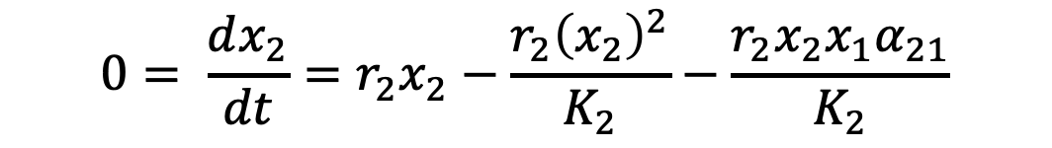
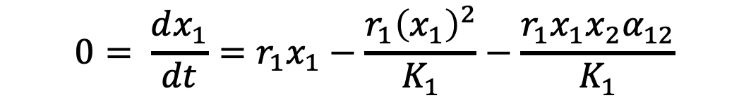
The 2-species Lotka-Volterra competition model has four equilibria.
Remember: equilibrium occurs when neither population is changing!
$$0= \frac{dx_{1}}{dt}={r_{1}x}_{1}−\frac{r_{1}{\left(x_{1}\right)}^{2}}{K_{1}}−\frac{r_{1}x_{1}x_{2}α_{12}}{K_{1}}$$
$$0= \frac{dx_{2}}{dt}={r_{2}x}_{2}−\frac{r_{2}{\left(x_{2}\right)}^{2}}{K_{2}}−\frac{r_{2}x_{2}x_{1}α_{21}}{K_{2}}$$

Slide 44
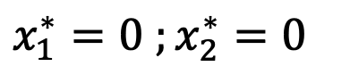
The 2-species Lotka-Volterra competition model has four equilibria.
Remember: equilibrium occurs when neither population is changing!
$$0= \frac{dx_{1}}{dt}={r_{1}x}_{1}−\frac{r_{1}{\left(x_{1}\right)}^{2}}{K_{1}}−\frac{r_{1}x_{1}x_{2}α_{12}}{K_{1}}$$
$$0= \frac{dx_{2}}{dt}={r_{2}x}_{2}−\frac{r_{2}{\left(x_{2}\right)}^{2}}{K_{2}}−\frac{r_{2}x_{2}x_{1}α_{21}}{K_{2}}$$
Four equilibria at:
$$x_{1}^{∗}=0 ;x_{2}^{∗}=0$$
Trivial.

Slide 45
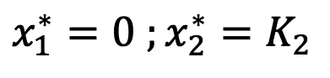
The 2-species Lotka-Volterra competition model has four equilibria.
Remember: equilibrium occurs when neither population is changing!
$$0= \frac{dx_{1}}{dt}={r_{1}x}_{1}−\frac{r_{1}{\left(x_{1}\right)}^{2}}{K_{1}}−\frac{r_{1}x_{1}x_{2}α_{12}}{K_{1}}$$
$$0= \frac{dx_{2}}{dt}={r_{2}x}_{2}−\frac{r_{2}{\left(x_{2}\right)}^{2}}{K_{2}}−\frac{r_{2}x_{2}x_{1}α_{21}}{K_{2}}$$
Four equilibria at:
$$x_{1}^{∗}=0 ;x_{2}^{∗}=0$$
$$x_{1}^{∗}=0 ;x_{2}^{∗}=K_{2}$$
Species 1 extinct. Species 2 at carrying capacity.

Slide 46
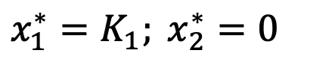
The 2-species Lotka-Volterra competition model has four equilibria.
Remember: equilibrium occurs when neither population is changing!
$$0= \frac{dx_{1}}{dt}={r_{1}x}_{1}−\frac{r_{1}{\left(x_{1}\right)}^{2}}{K_{1}}−\frac{r_{1}x_{1}x_{2}α_{12}}{K_{1}}$$
$$0= \frac{dx_{2}}{dt}={r_{2}x}_{2}−\frac{r_{2}{\left(x_{2}\right)}^{2}}{K_{2}}−\frac{r_{2}x_{2}x_{1}α_{21}}{K_{2}}$$
Four equilibria at:
$$x_{1}^{∗}=0 ;x_{2}^{∗}=0$$
$$x_{1}^{∗}=0 ;x_{2}^{∗}=K_{2}$$
$$x_{1}^{∗}=K_{1}; x_{2}^{∗}=0$$
Species 2 extinct. Species 1 at carrying capacity.

Slide 47
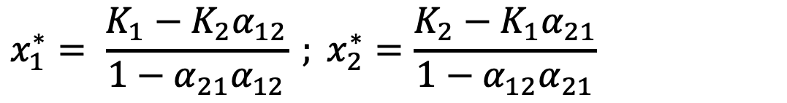
The 2-species Lotka-Volterra competition model has four equilibria.
Remember: equilibrium occurs when neither population is changing!
$$0= \frac{dx_{1}}{dt}={r_{1}x}_{1}−\frac{r_{1}{\left(x_{1}\right)}^{2}}{K_{1}}−\frac{r_{1}x_{1}x_{2}α_{12}}{K_{1}}$$
$$0= \frac{dx_{2}}{dt}={r_{2}x}_{2}−\frac{r_{2}{\left(x_{2}\right)}^{2}}{K_{2}}−\frac{r_{2}x_{2}x_{1}α_{21}}{K_{2}}$$
Four equilibria at:
$$x_{1}^{∗}=0 ;x_{2}^{∗}=0$$
$$x_{1}^{∗}=0 ;x_{2}^{∗}=K_{2}$$
$$x_{1}^{∗}=K_{1}; x_{2}^{∗}=0$$
$$x_{1}^{∗}= \frac{K_{1}−K_{2}α_{12}}{1−α_{21}α_{12}} ; x_{2}^{∗}=\frac{K_{2}−K_{1}α_{21}}{1−α_{12}α_{21}}$$
Coexistence.

Slide 48
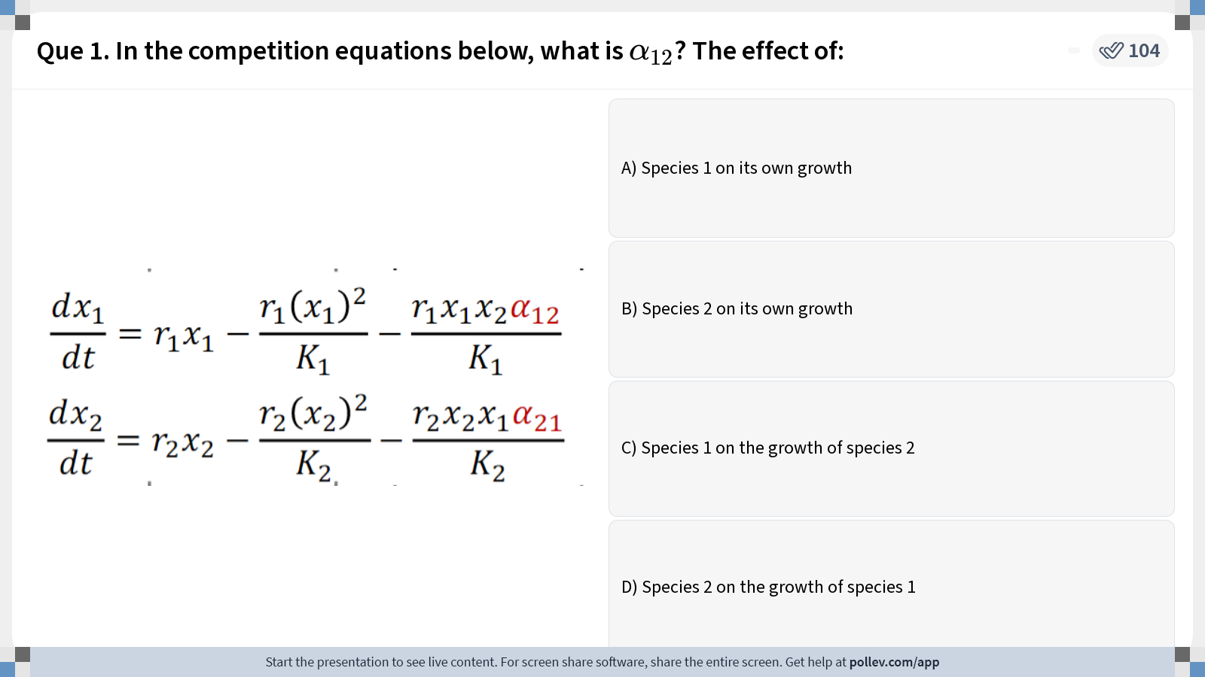
Notes:
Do not modify the notes in this section to avoid tampering with the Poll Everywhere activity. More info at polleverywhere.com/support Que 1. In the competition equations below, what is $$\alpha_{12}$$? The effect of:
https://www.polleverywhere.com/multiple_choice_polls/mbDBFx8aDhR1xJp?display_state=instructions&activity_state=opened&state=opened&flow=Instructor&onscreen=persist

Slide 49
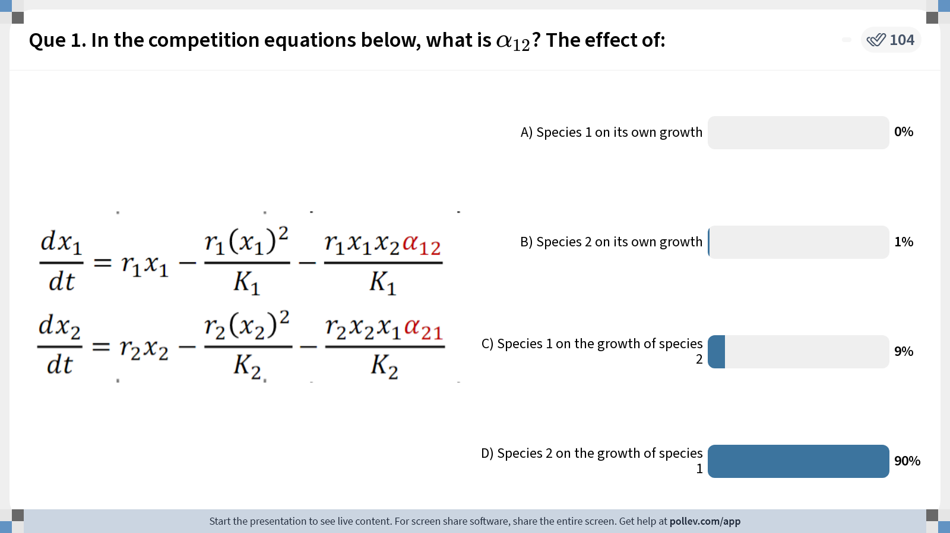
Notes:
Do not modify the notes in this section to avoid tampering with the Poll Everywhere activity. More info at polleverywhere.com/support Que 1. In the competition equations below, what is $$\alpha_{12}$$? The effect of:
https://www.polleverywhere.com/multiple_choice_polls/mbDBFx8aDhR1xJp?display_state=chart&activity_state=closed&state=closed&flow=Instructor&onscreen=persist

Slide 50
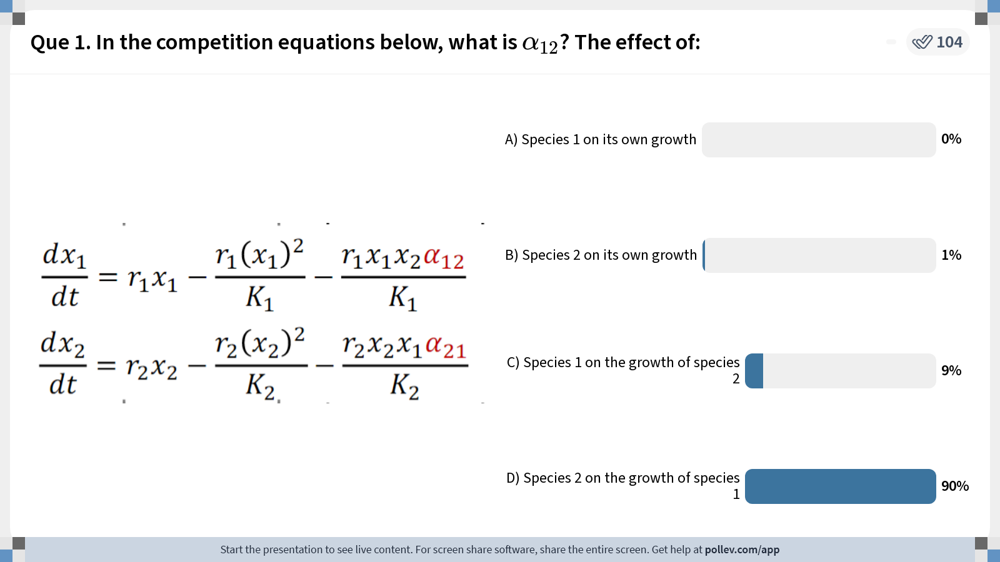
Notes:
Do not modify the notes in this section to avoid tampering with the Poll Everywhere activity. More info at polleverywhere.com/support Que 1. In the competition equations below, what is $$\alpha_{12}$$? The effect of:
https://www.polleverywhere.com/multiple_choice_polls/mbDBFx8aDhR1xJp?display_state=chart&activity_state=closed&display=correctness&state=closed&flow=Instructor&onscreen=persist

Slide 51
Nullclines (or isoclines) of the Lotka-Volterra competition model
These are the lines that correspond to the conditions when the rate of change for one species is not changing!
Notes:
For 2024, explain these phase planes as trajectories of the system. Each nullcline represents the conditions under which the RATE of change for each species is not changing. The two will eventually converge to the equilibria but at different rates. That rate will cease changing for each species when you reach the nullcline.
Also would be helpful to show the time series of the two species and how that translates to the nullcline.

Slide 52
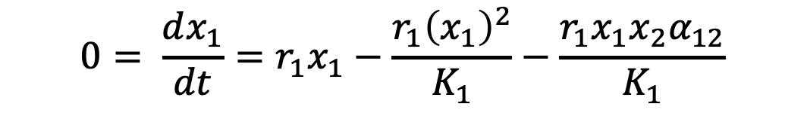





Nullclines (or isoclines) of the Lotka-Volterra competition model
These are the lines that correspond to conditions when the rate of change for one species is 0.
Nullclines for species 1 occur at all conditions for which $\frac{dx_{1}}{dt}=0$
$$0= \frac{dx_{1}}{dt}={r_{1}x}_{1}−\frac{r_{1}{\left(x_{1}\right)}^{2}}{K_{1}}−\frac{r_{1}x_{1}x_{2}α_{12}}{K_{1}}$$
$$big$$
$$x_{2}$$
$$0$$
$$x_{1}$$
$$big$$

Slide 53


Nullclines (or isoclines) of the Lotka-Volterra competition model
These are the lines that correspond to conditions when the rate of change for one species is 0.
Nullclines for species 1 occur at all conditions for which $\frac{dx_{1}}{dt}=0$
$$0= \frac{dx_{1}}{dt}={r_{1}x}_{1}−\frac{r_{1}{\left(x_{1}\right)}^{2}}{K_{1}}−\frac{r_{1}x_{1}x_{2}α_{12}}{K_{1}}$$
$$big$$
$$0={r_{1}x}_{1}−\frac{r_{1}{\left(x_{1}\right)}^{2}}{K_{1}}−\frac{r_{1}x_{1}x_{2}α_{12}}{K_{1}}$$
$$0={r_{1}x}_{1}\left(1−\frac{x_{1}}{K_{1}}−\frac{x_{2}α_{12}}{K_{1}}\right)$$
$$x_{2}$$
$$0$$
$$x_{1}$$
$$big$$

Slide 54




Nullclines (or isoclines) of the Lotka-Volterra competition model
These are the lines that correspond to conditions when the rate of change for one species is 0.
Nullclines for species 1 occur at all conditions for which $\frac{dx_{1}}{dt}=0$
$$0= \frac{dx_{1}}{dt}={r_{1}x}_{1}−\frac{r_{1}{\left(x_{1}\right)}^{2}}{K_{1}}−\frac{r_{1}x_{1}x_{2}α_{12}}{K_{1}}$$
$$0={r_{1}x}_{1}−\frac{r_{1}{\left(x_{1}\right)}^{2}}{K_{1}}−\frac{r_{1}x_{1}x_{2}α_{12}}{K_{1}}$$
$$0={r_{1}x}_{1}\left(1−\frac{x_{1}}{K_{1}}−\frac{x_{2}α_{12}}{K_{1}}\right)$$
$$x_{2}$$
first nullcline at $x_{1}=0$
$$0$$
$$x_{1}$$

Slide 55



Nullclines (or isoclines) of the Lotka-Volterra competition model
These are the lines that correspond to conditions when the rate of change for one species is 0.
Nullclines for species 1 occur at all conditions for which $\frac{dx_{1}}{dt}=0$
$$0= \frac{dx_{1}}{dt}={r_{1}x}_{1}−\frac{r_{1}{\left(x_{1}\right)}^{2}}{K_{1}}−\frac{r_{1}x_{1}x_{2}α_{12}}{K_{1}}$$
$$\frac{K_{1}}{α_{12}}$$
$$0={r_{1}x}_{1}−\frac{r_{1}{\left(x_{1}\right)}^{2}}{K_{1}}−\frac{r_{1}x_{1}x_{2}α_{12}}{K_{1}}$$
$$0={r_{1}x}_{1}\left(1−\frac{x_{1}}{K_{1}}−\frac{x_{2}α_{12}}{K_{1}}\right)$$
$$x_{2}$$
first nullcline at $x_{1}=0$
second nullcline at $x_{1}=−α_{12}x_{2}+K_{1}$
$$0$$
$$x_{1}$$
$$K_{1}$$

Slide 56
Nullclines (or isoclines) of the Lotka-Volterra competition model
Following a perturbation, the population should return to equilibrium!
$$\frac{K_{1}}{α_{12}}$$
$$x_{2}$$
$$0$$
$$x_{1}$$
$$K_{1}$$

Slide 57

Nullclines (or isoclines) of the Lotka-Volterra competition model
Following a perturbation, the population should return to equilibrium!
For $x_{1}$, this will always mean moving along the x-axis to the nullcline, then along the nullcline to equilibrium.
$$\frac{K_{1}}{α_{12}}$$
$$x_{2}$$
$$0$$
$$x_{1}$$
$$K_{1}$$

Slide 58
Nullclines (or isoclines) of the Lotka-Volterra competition model
Following a perturbation, the population should return to equilibrium!
For $x_{1}$, this will always mean moving along the x-axis to the nullcline, then along the nullcline to equilibrium.
$$\frac{K_{1}}{α_{12}}$$
$$x_{2}$$
$$0$$
$$x_{1}$$
$$K_{1}$$

Slide 59


Nullclines (or isoclines) of the Lotka-Volterra competition model
$$\frac{dx_{1}}{dt}={r_{1}x}_{1}\left(1−\frac{x_{1}}{K_{1}}−\frac{x_{2}α_{12}}{K_{1}}\right)$$
Following a perturbation, the population should return to equilibrium!
For $x_{1}$, this will always mean moving along the x-axis to the nullcline, then along the nullcline to equilibrium.
You can also test it by solving $\frac{dx_{1}}{dt}\text{for} \text{different} \text{values}\text{!}$
$$\frac{K_{1}}{α_{12}}$$
$$x_{2}$$
$$0$$
$$x_{1}$$
$$K_{1}$$

Slide 60





Nullclines (or isoclines) of the Lotka-Volterra competition model
$$\frac{dx_{1}}{dt}={r_{1}x}_{1}\left(1−\frac{x_{1}}{K_{1}}−\frac{x_{2}α_{12}}{K_{1}}\right)$$
Following a perturbation, the population should return to equilibrium!
For $x_{1}$, this will always mean moving along the x-axis to the nullcline, then along the nullcline to equilibrium.
You can also test it by solving $\frac{dx_{1}}{dt}\text{for} \text{different} \text{values}\text{!}$
$K_{1}=4 ;α_{12}=.5$
$$8$$
$$5, 6$$
$$x_{2}$$
$$0$$
$$x_{1}$$
$$4$$

Slide 61

Nullclines (or isoclines) of the Lotka-Volterra competition model
$$\frac{dx_{1}}{dt}={r_{1}x}_{1}\left(1−\frac{x_{1}}{K_{1}}−\frac{x_{2}α_{12}}{K_{1}}\right)$$
Following a perturbation, the population should return to equilibrium!
For $x_{1}$, this will always mean moving along the x-axis to the nullcline, then along the nullcline to equilibrium.
You can also test it by solving $\frac{dx_{1}}{dt}\text{for} \text{different} \text{values}\text{!}$
$K_{1}=4 ;α_{12}=.5$
$$\frac{dx_{1}}{dt}=r_{1}∗5\left(1−\frac{5}{4}−\frac{6∗.5}{4}\right)$$
$$8$$
$$5, 6$$
$$x_{2}$$
$$0$$
$$x_{1}$$
$$4$$

Slide 62

Nullclines (or isoclines) of the Lotka-Volterra competition model
$$\frac{dx_{1}}{dt}={r_{1}x}_{1}\left(1−\frac{x_{1}}{K_{1}}−\frac{x_{2}α_{12}}{K_{1}}\right)$$
Following a perturbation, the population should return to equilibrium!
For $x_{1}$, this will always mean moving along the x-axis to the nullcline, then along the nullcline to equilibrium.
You can also test it by solving $\frac{dx_{1}}{dt}\text{for} \text{different} \text{values}\text{!}$
$K_{1}=4 ;α_{12}=.5$
$$\frac{dx_{1}}{dt}=r_{1}∗5\left(1−\frac{5}{4}−\frac{6∗.5}{4}\right)$$
$$\frac{dx_{1}}{dt}=r_{1}∗5\left(1−1.25−.75\right)$$
$$8$$
$$5, 6$$
$$x_{2}$$
$$0$$
$$x_{1}$$
$$4$$

Slide 63

Nullclines (or isoclines) of the Lotka-Volterra competition model
$$\frac{dx_{1}}{dt}={r_{1}x}_{1}\left(1−\frac{x_{1}}{K_{1}}−\frac{x_{2}α_{12}}{K_{1}}\right)$$
Following a perturbation, the population should return to equilibrium!
For $x_{1}$, this will always mean moving along the x-axis to the nullcline, then along the nullcline to equilibrium.
You can also test it by solving $\frac{dx_{1}}{dt}\text{for} \text{different} \text{values}\text{!}$
$K_{1}=4 ;α_{12}=.5$
$$\frac{dx_{1}}{dt}=r_{1}∗5\left(1−\frac{5}{4}−\frac{6∗.5}{4}\right)$$
$$\frac{dx_{1}}{dt}=\left(−\right)$$
$$8$$
$$5, 6$$
$$x_{2}$$
$$0$$
$$x_{1}$$
$$4$$

Slide 64

Nullclines (or isoclines) of the Lotka-Volterra competition model
$$\frac{dx_{1}}{dt}={r_{1}x}_{1}\left(1−\frac{x_{1}}{K_{1}}−\frac{x_{2}α_{12}}{K_{1}}\right)$$
Following a perturbation, the population should return to equilibrium!
For $x_{1}$, this will always mean moving along the x-axis to the nullcline, then along the nullcline to equilibrium.
You can also test it by solving $\frac{dx_{1}}{dt}\text{for} \text{different} \text{values}\text{!}$
$K_{1}=4 ;α_{12}=.5$
$$8$$
$$x_{2}$$
$$1, 5$$
$$0$$
$$x_{1}$$
$$4$$

Slide 65

Nullclines (or isoclines) of the Lotka-Volterra competition model
$$\frac{dx_{1}}{dt}={r_{1}x}_{1}\left(1−\frac{x_{1}}{K_{1}}−\frac{x_{2}α_{12}}{K_{1}}\right)$$
Following a perturbation, the population should return to equilibrium!
For $x_{1}$, this will always mean moving along the x-axis to the nullcline, then along the nullcline to equilibrium.
You can also test it by solving $\frac{dx_{1}}{dt}\text{for} \text{different} \text{values}\text{!}$
$K_{1}=4 ;α_{12}=.5$
$$\frac{dx_{1}}{dt}=r_{1}∗1\left(1−\frac{1}{4}−\frac{5∗.5}{4}\right)$$
$$8$$
$$x_{2}$$
$$1, 5$$
$$0$$
$$x_{1}$$
$$4$$

Slide 66

Nullclines (or isoclines) of the Lotka-Volterra competition model
$$\frac{dx_{1}}{dt}={r_{1}x}_{1}\left(1−\frac{x_{1}}{K_{1}}−\frac{x_{2}α_{12}}{K_{1}}\right)$$
Following a perturbation, the population should return to equilibrium!
For $x_{1}$, this will always mean moving along the x-axis to the nullcline, then along the nullcline to equilibrium.
You can also test it by solving $\frac{dx_{1}}{dt}\text{for} \text{different} \text{values}\text{!}$
$K_{1}=4 ;α_{12}=.5$
$$\frac{dx_{1}}{dt}=r_{1}∗1\left(1−\frac{1}{4}−\frac{5∗.5}{4}\right)$$
$$\frac{dx_{1}}{dt}=r_{1}∗1\left(1−.25−.56\right)$$
$$8$$
$$x_{2}$$
$$1, 5$$
$$0$$
$$x_{1}$$
$$4$$

Slide 67

Nullclines (or isoclines) of the Lotka-Volterra competition model
$$\frac{dx_{1}}{dt}={r_{1}x}_{1}\left(1−\frac{x_{1}}{K_{1}}−\frac{x_{2}α_{12}}{K_{1}}\right)$$
Following a perturbation, the population should return to equilibrium!
For $x_{1}$, this will always mean moving along the x-axis to the nullcline, then along the nullcline to equilibrium.
You can also test it by solving $\frac{dx_{1}}{dt}\text{for} \text{different} \text{values}\text{!}$
$K_{1}=4 ;α_{12}=.5$
$$\frac{dx_{1}}{dt}=r_{1}∗1\left(1−\frac{1}{4}−\frac{5∗.5}{4}\right)$$
$$\frac{dx_{1}}{dt}=\left(+\right)$$
$$8$$
$$x_{2}$$
$$1, 5$$
$$0$$
$$x_{1}$$
$$4$$

Slide 68
Nullclines (or isoclines) of the Lotka-Volterra competition model
These are the lines that correspond to conditions when the rate of change for one species is 0.
Nullclines for species 2 occur at all conditions for which $\frac{dx_{2}}{dt}=0$
$$x_{2}$$
$$0$$
$$x_{1}$$

Slide 69



Nullclines (or isoclines) of the Lotka-Volterra competition model
These are the lines that correspond to conditions when the rate of change for one species is 0.
Nullclines for species 2 occur at all conditions for which $\frac{dx_{2}}{dt}=0$
$$0= \frac{dx_{2}}{dt}={r_{2}x}_{2}−\frac{r_{2}{\left(x_{2}\right)}^{2}}{K_{2}}−\frac{r_{2}x_{2}x_{1}α_{21}}{K_{2}}$$
$$0={r_{2}x}_{2}−\frac{r_{2}{\left(x_{2}\right)}^{2}}{K_{2}}−\frac{r_{2}x_{2}x_{1}α_{21}}{K_{2}}$$
$$0={r_{2}x}_{2}\left(1−\frac{x_{2}}{K_{2}}−\frac{x_{1}α_{21}}{K_{2}}\right)$$
$$x_{2}$$
$$0$$
$$x_{1}$$

Slide 70

Nullclines (or isoclines) of the Lotka-Volterra competition model
These are the lines that correspond to conditions when the rate of change for one species is 0.
Nullclines for species 2 occur at all conditions for which $\frac{dx_{2}}{dt}=0$
$$0= \frac{dx_{2}}{dt}={r_{2}x}_{2}−\frac{r_{2}{\left(x_{2}\right)}^{2}}{K_{2}}−\frac{r_{2}x_{2}x_{1}α_{21}}{K_{2}}$$
$$0={r_{2}x}_{2}−\frac{r_{2}{\left(x_{2}\right)}^{2}}{K_{2}}−\frac{r_{2}x_{2}x_{1}α_{21}}{K_{2}}$$
$$0={r_{2}x}_{2}\left(1−\frac{x_{2}}{K_{2}}−\frac{x_{1}α_{21}}{K_{2}}\right)$$
first nullcline at $x_{2}=0$
$$0$$
$$x_{1}$$

Slide 71




Nullclines (or isoclines) of the Lotka-Volterra competition model
These are the lines that correspond to conditions when the rate of change for one species is 0.
Nullclines for species 2 occur at all conditions for which $\frac{dx_{2}}{dt}=0$
$$0= \frac{dx_{2}}{dt}={r_{2}x}_{2}−\frac{r_{2}{\left(x_{2}\right)}^{2}}{K_{2}}−\frac{r_{2}x_{2}x_{1}α_{21}}{K_{2}}$$
$$0={r_{2}x}_{2}−\frac{r_{2}{\left(x_{2}\right)}^{2}}{K_{2}}−\frac{r_{2}x_{2}x_{1}α_{21}}{K_{2}}$$
$$0={r_{2}x}_{2}\left(1−\frac{x_{2}}{K_{2}}−\frac{x_{1}α_{21}}{K_{2}}\right)$$
$$x_{2}$$
$$K_{2}$$
first nullcline at $x_{2}=0$
second nullcline at $x_{2}=−α_{2a}x_{1}+K_{2}$
$$0$$
$$x_{1}$$
$$\frac{K_{2}}{α_{21}}$$

Slide 72
Nullclines (or isoclines) of the Lotka-Volterra competition model
Following a perturbation, the population should return to equilibrium!
$$x_{2}$$
$$K_{2}$$
$$0$$
$$x_{1}$$
$$\frac{K_{2}}{α_{21}}$$

Slide 73

Nullclines (or isoclines) of the Lotka-Volterra competition model
Following a perturbation, the population should return to equilibrium!
For $x_{2}$, this will always mean moving along the y-axis to the nullcline, then along the nullcline to equilibrium.
$$x_{2}$$
$$K_{2}$$
$$0$$
$$x_{1}$$
$$\frac{K_{2}}{α_{21}}$$

Slide 74



Nullclines (or isoclines) of the Lotka-Volterra competition model
$${{\frac{dx_{2}}{dt}=r}_{2}x}_{2}\left(1−\frac{x_{2}}{K_{2}}−\frac{x_{1}α_{21}}{K_{2}}\right)$$
Following a perturbation, the population should return to equilibrium!
For $x_{2}$, this will always mean moving along the y-axis to the nullcline, then along the nullcline to equilibrium.
You can also test it by solving $\frac{dx_{2}}{dt}\text{for} \text{different} \text{values}\text{!}$
$$x_{2}$$
$$K_{2}$$
$$0$$
$$x_{1}$$
$$\frac{K_{2}}{α_{21}}$$

Slide 75




Nullclines (or isoclines) of the Lotka-Volterra competition model
$${{\frac{dx_{2}}{dt}=r}_{2}x}_{2}\left(1−\frac{x_{2}}{K_{2}}−\frac{x_{1}α_{21}}{K_{2}}\right)$$
Following a perturbation, the population should return to equilibrium!
For $x_{2}$, this will always mean moving along the y-axis to the nullcline, then along the nullcline to equilibrium.
You can also test it by solving $\frac{dx_{2}}{dt}\text{for} \text{different} \text{values}\text{!}$
$K_{2}=6 ;α_{21}=.3$
$$x_{2}$$
$$7, 8$$
$$6$$
$$0$$
$$x_{1}$$
$$20$$

Slide 76

Nullclines (or isoclines) of the Lotka-Volterra competition model
$${{\frac{dx_{2}}{dt}=r}_{2}x}_{2}\left(1−\frac{x_{2}}{K_{2}}−\frac{x_{1}α_{21}}{K_{2}}\right)$$
Following a perturbation, the population should return to equilibrium!
For $x_{2}$, this will always mean moving along the y-axis to the nullcline, then along the nullcline to equilibrium.
You can also test it by solving $\frac{dx_{2}}{dt}\text{for} \text{different} \text{values}\text{!}$
$K_{2}=6 ;α_{21}=.3$
$$x_{2}$$
$${\frac{dx_{2}}{dt}=r}_{2}∗8\left(1−\frac{8}{6}−\frac{7∗.3}{6}\right)$$
$$7, 8$$
$$6$$
$$0$$
$$x_{1}$$
$$20$$

Slide 77

Nullclines (or isoclines) of the Lotka-Volterra competition model
$${{\frac{dx_{2}}{dt}=r}_{2}x}_{2}\left(1−\frac{x_{2}}{K_{2}}−\frac{x_{1}α_{21}}{K_{2}}\right)$$
Following a perturbation, the population should return to equilibrium!
For $x_{2}$, this will always mean moving along the y-axis to the nullcline, then along the nullcline to equilibrium.
You can also test it by solving $\frac{dx_{2}}{dt}\text{for} \text{different} \text{values}\text{!}$
$K_{2}=6 ;α_{21}=.3$
$$x_{2}$$
$${\frac{dx_{2}}{dt}=r}_{2}∗8\left(1−\frac{8}{6}−\frac{7∗.3}{6}\right)$$
$${\frac{dx_{2}}{dt}=r}_{2}∗8\left(1−1.3−.35\right)$$
$$7, 8$$
$$6$$
$$0$$
$$x_{1}$$
$$20$$

Slide 78


Nullclines (or isoclines) of the Lotka-Volterra competition model
$${{\frac{dx_{2}}{dt}=r}_{2}x}_{2}\left(1−\frac{x_{2}}{K_{2}}−\frac{x_{1}α_{21}}{K_{2}}\right)$$
Following a perturbation, the population should return to equilibrium!
For $x_{2}$, this will always mean moving along the y-axis to the nullcline, then along the nullcline to equilibrium.
You can also test it by solving $\frac{dx_{2}}{dt}\text{for} \text{different} \text{values}\text{!}$
$K_{2}=6 ;α_{21}=.3$
$$x_{2}$$
$${\frac{dx_{2}}{dt}=r}_{2}∗8\left(1−\frac{8}{6}−\frac{7∗.3}{6}\right)$$
$$\frac{dx_{2}}{dt}=\left(−\right)$$
$$7, 8$$
$$6$$
$$0$$
$$x_{1}$$
$$20$$

Slide 79

Nullclines (or isoclines) of the Lotka-Volterra competition model
$${{\frac{dx_{2}}{dt}=r}_{2}x}_{2}\left(1−\frac{x_{2}}{K_{2}}−\frac{x_{1}α_{21}}{K_{2}}\right)$$
Following a perturbation, the population should return to equilibrium!
For $x_{2}$, this will always mean moving along the y-axis to the nullcline, then along the nullcline to equilibrium.
You can also test it by solving $\frac{dx_{2}}{dt}\text{for} \text{different} \text{values}\text{!}$
$K_{2}=6 ;α_{21}=.3$
$$x_{2}$$
$$6$$
$$4, 2$$
$$0$$
$$x_{1}$$
$$20$$

Slide 80

Nullclines (or isoclines) of the Lotka-Volterra competition model
$${{\frac{dx_{2}}{dt}=r}_{2}x}_{2}\left(1−\frac{x_{2}}{K_{2}}−\frac{x_{1}α_{21}}{K_{2}}\right)$$
Following a perturbation, the population should return to equilibrium!
For $x_{2}$, this will always mean moving along the y-axis to the nullcline, then along the nullcline to equilibrium.
You can also test it by solving $\frac{dx_{2}}{dt}\text{for} \text{different} \text{values}\text{!}$
$K_{2}=6 ;α_{21}=.3$
$$x_{2}$$
$${\frac{dx_{2}}{dt}=r}_{2}∗2\left(1−\frac{2}{6}−\frac{4∗.3}{6}\right)$$
$$6$$
$$4, 2$$
$$0$$
$$x_{1}$$
$$20$$

Slide 81

Nullclines (or isoclines) of the Lotka-Volterra competition model
$${{\frac{dx_{2}}{dt}=r}_{2}x}_{2}\left(1−\frac{x_{2}}{K_{2}}−\frac{x_{1}α_{21}}{K_{2}}\right)$$
Following a perturbation, the population should return to equilibrium!
For $x_{2}$, this will always mean moving along the y-axis to the nullcline, then along the nullcline to equilibrium.
You can also test it by solving $\frac{dx_{2}}{dt}\text{for} \text{different} \text{values}\text{!}$
$K_{2}=6 ;α_{21}=.3$
$$x_{2}$$
$${\frac{dx_{2}}{dt}=r}_{2}∗2\left(1−\frac{2}{6}−\frac{4∗.3}{6}\right)$$
$${\frac{dx_{2}}{dt}=r}_{2}∗2\left(1−.33−.2\right)$$
$$6$$
$$4, 2$$
$$0$$
$$x_{1}$$
$$20$$

Slide 82



Nullclines (or isoclines) of the Lotka-Volterra competition model
$${{\frac{dx_{2}}{dt}=r}_{2}x}_{2}\left(1−\frac{x_{2}}{K_{2}}−\frac{x_{1}α_{21}}{K_{2}}\right)$$
Following a perturbation, the population should return to equilibrium!
For $x_{2}$, this will always mean moving along the y-axis to the nullcline, then along the nullcline to equilibrium.
You can also test it by solving $\frac{dx_{2}}{dt}\text{for} \text{different} \text{values}\text{!}$
$K_{2}=6 ;α_{21}=.3$
$$x_{2}$$
$${\frac{dx_{2}}{dt}=r}_{2}∗2\left(1−\frac{2}{6}−\frac{4∗.3}{6}\right)$$
$$\frac{dx_{2}}{dt}=\left(+\right)$$
$$6$$
$$4, 2$$
$$0$$
$$x_{1}$$
$$20$$

Slide 83

Given different combinations of $x_{1}$and $x_{2}$ what is the outcome of competition?
$$\frac{K_{1}}{α_{12}}$$
$$x_{2}$$
$$K_{2}$$
$$0$$
$$x_{1}$$
$$K_{1}$$
$$\frac{K_{2}}{α_{21}}$$

Slide 84


Given different combinations of $x_{1}$and $x_{2}$ what is the outcome of competition?
System will converge to one of its equilibria, depending on the values of the competition and carrying capacity parameters.
We can solve $\frac{dx_{1}}{dt} \text{at} \text{different} \text{combinations} \text{of} x_{1}$and $x_{2}$ to test the direction the $x_{1}$population will move during competition (always along the x-axis).
We can solve $\frac{dx_{2}}{dt} \text{at} \text{different} \text{combinations} \text{of} x_{1}$and $x_{2}$ to test the direction the $x_{2}$population will move during competition (always along the y-axis).
$$x_{2}$$
$$\frac{K_{1}}{α_{12}}$$
$$K_{2}$$
$$0$$
$$x_{1}$$
$$K_{1}$$
$$\frac{K_{2}}{α_{21}}$$

Slide 85









Given different combinations of $x_{1}$and $x_{2}$ what is the outcome of competition?
$$\frac{K_{1}}{α_{12}}$$
$$x_{2}$$
$$x_{2}$$
$$K_{2}$$
$$0$$
$$x_{1}$$
$$0$$
$$x_{1}$$
$$K_{1}$$
$$\frac{K_{2}}{α_{21}}$$
We can use vector addition from the individual nullclines to determine the outcome of competition.

Slide 86
Given different combinations of $x_{1}$and $x_{2}$ what is the outcome of competition?
System will converge to one of its equilibria, depending on the values of the competition and carrying capacity parameters.
We can use vector addition in each quadrat from the individual nullclines to determine the outcome of competition.
$$x_{2}$$
$$\frac{K_{1}}{α_{12}}$$
$$K_{2}$$
$$0$$
$$x_{1}$$
$$K_{1}$$
$$\frac{K_{2}}{α_{21}}$$

Slide 87

Given different combinations of $x_{1}$and $x_{2}$ what is the outcome of competition?
System will converge to one of its equilibria, depending on the values of the competition and carrying capacity parameters.
We can use vector addition in each quadrat from the individual nullclines to determine the outcome of competition.
This configuration is a stable equilibrium, indicating stable coexistence at:
$$x_{2}$$
$$\frac{K_{1}}{α_{12}}$$
$$K_{2}$$
$$0$$
$$x_{1}$$
$$x_{1}^{∗}= \frac{K_{1}−K_{2}α_{12}}{1−α_{21}α_{12}} x_{2}^{∗}=\frac{K_{2}−K_{1}α_{21}}{1−α_{12}α_{21}}$$
$$K_{1}$$
$$\frac{K_{2}}{α_{21}}$$

Slide 88

Given different combinations of $x_{1}$and $x_{2}$ what is the outcome of competition?
Like before, we can also solve $\frac{dx_{1}}{dt} \text{at} \text{different} \text{combinations} \text{of} x_{1}$and $x_{2}$ to test the direction the $x_{1}$population will move during competition (always along the x-axis).
We can solve $\frac{dx_{2}}{dt} \text{at} \text{different} \text{combinations} \text{of} x_{1}$and $x_{2}$ to test the direction the $x_{2}$population will move during competition (always along the y-axis).
$$x_{2}$$
$$\frac{K_{1}}{α_{12}}$$
$$K_{2}$$
$$0$$
$$x_{1}$$
$$K_{1}$$
$$\frac{K_{2}}{α_{21}}$$

Slide 89
Given different combinations of $x_{1}$and $x_{2}$ what is the outcome of competition?
Like before, we can also solve $\frac{dx_{1}}{dt} \text{at} \text{different} \text{combinations} \text{of} x_{1}$and $x_{2}$ to test the direction the $x_{1}$population will move during competition (always along the x-axis).
We can solve $\frac{dx_{2}}{dt} \text{at} \text{different} \text{combinations} \text{of} x_{1}$and $x_{2}$ to test the direction the $x_{2}$population will move during competition (always along the y-axis).
$$x_{2}$$
$$\frac{K_{1}}{α_{12}}$$
$$K_{2}$$
$$0$$
$$x_{1}$$
$$K_{1}$$
$$\frac{K_{2}}{α_{21}}$$

Slide 90





Given different combinations of $x_{1}$and $x_{2}$ what is the outcome of competition?
Let’s try it!
$$K_{1}=2 ;α_{12}=.3$$
$$K_{2}=8 ;α_{21}=.8$$
$$x_{2}$$
$\frac{K_{1}}{α_{12}}$=10
$K_{2}$=8
$$0$$
$$x_{1}$$
$$\frac{K_{2}}{α_{21}}=10$$
$K_{1}$=2

Slide 91

Given different combinations of $x_{1}$and $x_{2}$ what is the outcome of competition?
Let’s try it!
$$K_{1}=2 ;α_{12}=.3$$
$$K_{2}=8 ;α_{21}=.8$$
$$x_{2}$$
$\frac{K_{1}}{α_{12}}$=10
$$\frac{dx_{1}}{dt}={r_{1}x}_{1}\left(1−\frac{x_{1}}{K_{1}}−\frac{x_{2}α_{12}}{K_{1}}\right)$$
$K_{2}$=8
3, 2
$$0$$
$$x_{1}$$
$$\frac{K_{2}}{α_{21}}=10$$
$K_{1}$=2

Slide 92

Given different combinations of $x_{1}$and $x_{2}$ what is the outcome of competition?
Let’s try it!
$$K_{1}=2 ;α_{12}=.3$$
$$K_{2}=8 ;α_{21}=.8$$
$$x_{2}$$
$\frac{K_{1}}{α_{12}}$=10
$$\frac{dx_{1}}{dt}={r_{1}x}_{1}\left(1−\frac{x_{1}}{K_{1}}−\frac{x_{2}α_{12}}{K_{1}}\right)$$
$K_{2}$=8
$$\frac{dx_{1}}{dt}=r_{1}∗3\left(1−\frac{3}{2}−\frac{2∗.3}{2}\right)$$
3, 2
$$0$$
$$x_{1}$$
$$\frac{K_{2}}{α_{21}}=10$$
$K_{1}$=2

Slide 93

Given different combinations of $x_{1}$and $x_{2}$ what is the outcome of competition?
Let’s try it!
$$K_{1}=2 ;α_{12}=.3$$
$$K_{2}=8 ;α_{21}=.8$$
$$x_{2}$$
$\frac{K_{1}}{α_{12}}$=10
$$\frac{dx_{1}}{dt}={r_{1}x}_{1}\left(1−\frac{x_{1}}{K_{1}}−\frac{x_{2}α_{12}}{K_{1}}\right)$$
$K_{2}$=8
$$\frac{dx_{1}}{dt}=r_{1}∗3\left(1−\frac{3}{2}−\frac{2∗.3}{2}\right)$$
3, 2
$$\frac{dx_{1}}{dt}=r_{1}∗3\left(1−1.5−0.3\right)$$
$$0$$
$$x_{1}$$
$$\frac{K_{2}}{α_{21}}=10$$
$K_{1}$=2

Slide 94




Given different combinations of $x_{1}$and $x_{2}$ what is the outcome of competition?
Let’s try it!
$$K_{1}=2 ;α_{12}=.3$$
$$K_{2}=8 ;α_{21}=.8$$
$$x_{2}$$
$\frac{K_{1}}{α_{12}}$=10
$$\frac{dx_{1}}{dt}={r_{1}x}_{1}\left(1−\frac{x_{1}}{K_{1}}−\frac{x_{2}α_{12}}{K_{1}}\right)$$
$$\frac{dx_{1}}{dt}=r_{1}∗3\left(1−\frac{3}{2}−\frac{2∗.3}{2}\right)$$
$K_{2}$=8
$$\frac{dx_{1}}{dt}=r_{1}∗3\left(1−1.5−0.3\right)$$
3, 2
$$0$$
$$x_{1}$$
$$\frac{K_{2}}{α_{21}}=10$$
$K_{1}$=2
$$\frac{dx_{1}}{dt}=\left(−\right)$$

Slide 95

Given different combinations of $x_{1}$and $x_{2}$ what is the outcome of competition?
Let’s try it!
$$K_{1}=2 ;α_{12}=.3$$
$$K_{2}=8 ;α_{21}=.8$$
$$x_{2}$$
$\frac{K_{1}}{α_{12}}$=10
$${{\frac{dx_{2}}{dt}=r}_{2}x}_{2}\left(1−\frac{x_{2}}{K_{2}}−\frac{x_{1}α_{21}}{K_{2}}\right)$$
$K_{2}$=8
3, 2
$$0$$
$$x_{1}$$
$$\frac{K_{2}}{α_{21}}=10$$
$K_{1}$=2

Slide 96

Given different combinations of $x_{1}$and $x_{2}$ what is the outcome of competition?
Let’s try it!
$$K_{1}=2 ;α_{12}=.3$$
$$K_{2}=8 ;α_{21}=.8$$
$$x_{2}$$
$\frac{K_{1}}{α_{12}}$=10
$${{\frac{dx_{2}}{dt}=r}_{2}x}_{2}\left(1−\frac{x_{2}}{K_{2}}−\frac{x_{1}α_{21}}{K_{2}}\right)$$
$K_{2}$=8
$${\frac{dx_{2}}{dt}=r}_{2}∗2\left(1−\frac{2}{8}−\frac{3∗.3}{8}\right)$$
3, 2
$$0$$
$$x_{1}$$
$$\frac{K_{2}}{α_{21}}=10$$
$K_{1}$=2

Slide 97

Given different combinations of $x_{1}$and $x_{2}$ what is the outcome of competition?
Let’s try it!
$$K_{1}=2 ;α_{12}=.3$$
$$K_{2}=8 ;α_{21}=.8$$
$$x_{2}$$
$\frac{K_{1}}{α_{12}}$=10
$${{\frac{dx_{2}}{dt}=r}_{2}x}_{2}\left(1−\frac{x_{2}}{K_{2}}−\frac{x_{1}α_{21}}{K_{2}}\right)$$
$K_{2}$=8
$${\frac{dx_{2}}{dt}=r}_{2}∗2\left(1−\frac{2}{8}−\frac{3∗.3}{8}\right)$$
3, 2
$${\frac{dx_{2}}{dt}=r}_{2}∗2\left(1−.25−.113\right)$$
$$0$$
$$x_{1}$$
$$\frac{K_{2}}{α_{21}}=10$$
$K_{1}$=2

Slide 98




Given different combinations of $x_{1}$and $x_{2}$ what is the outcome of competition?
Let’s try it!
$$K_{1}=2 ;α_{12}=.3$$
$$K_{2}=8 ;α_{21}=.8$$
$$x_{2}$$
$\frac{K_{1}}{α_{12}}$=10
$${{\frac{dx_{2}}{dt}=r}_{2}x}_{2}\left(1−\frac{x_{2}}{K_{2}}−\frac{x_{1}α_{21}}{K_{2}}\right)$$
$${\frac{dx_{2}}{dt}=r}_{2}∗2\left(1−\frac{2}{8}−\frac{3∗.3}{8}\right)$$
$K_{2}$=8
$${\frac{dx_{2}}{dt}=r}_{2}∗2\left(1−.25−.113\right)$$
3, 2
$$0$$
$$x_{1}$$
$$\frac{K_{2}}{α_{21}}=10$$
$K_{1}$=2
$$\frac{dx_{2}}{dt}=\left(+\right)$$

Slide 99

Given different combinations of $x_{1}$and $x_{2}$ what is the outcome of competition?
Let’s try it!
$$K_{1}=2 ;α_{12}=.3$$
$$K_{2}=8 ;α_{21}=.8$$
Results replicate graphical approach!
$$x_{2}$$
$\frac{K_{1}}{α_{12}}$=10
$K_{2}$=8
3, 2
$$0$$
$$x_{1}$$
$$\frac{K_{2}}{α_{21}}=10$$
$K_{1}$=2

Slide 100

Four possible outcomes for competition
Case 1:
Stable equilibrium, with coexistence at:
$$x_{2}$$
$$x_{1}^{∗}= \frac{K_{1}−K_{2}α_{12}}{1−α_{21}α_{12}} x_{2}^{∗}=\frac{K_{2}−K_{1}α_{21}}{1−α_{12}α_{21}}$$
$$\frac{K_{1}}{α_{12}}$$
$$K_{2}$$
$$0$$
$$x_{1}$$
$$K_{1}$$
$$\frac{K_{2}}{α_{21}}$$

Slide 101


Four possible outcomes for competition
Case 1:
Stable equilibrium, with coexistence at:
$$x_{2}$$
$$x_{1}^{∗}= \frac{K_{1}−K_{2}α_{12}}{1−α_{21}α_{12}} x_{2}^{∗}=\frac{K_{2}−K_{1}α_{21}}{1−α_{12}α_{21}}$$
$$\frac{K_{1}}{α_{12}}$$
$$\frac{K_{1}}{α_{12}}>K_{2} \&\frac{K_{2}}{α_{21}}>K_{1}$$
$$K_{2}$$
$${(α_{12}∗ α}_{21}<1)$$
$$0$$
$$x_{1}$$
$$K_{1}$$
$$\frac{K_{2}}{α_{21}}$$

Slide 102
Four possible outcomes for competition
Case 1:
Stable equilibrium, with coexistence at:
$$x_{2}$$
$$x_{1}^{∗}= \frac{K_{1}−K_{2}α_{12}}{1−α_{21}α_{12}} x_{2}^{∗}=\frac{K_{2}−K_{1}α_{21}}{1−α_{12}α_{21}}$$
$$\frac{K_{1}}{α_{12}}$$
$$\frac{K_{1}}{α_{12}}>K_{2} \&\frac{K_{2}}{α_{21}}>K_{1}$$
$$K_{2}$$
$${(α_{12}∗ α}_{21}<1)$$
Species coexist stably but below carrying capacity for each individual population.
Intraspecific competition is stronger than interspecific competition.
$$0$$
$$x_{1}$$
$$K_{1}$$
$$\frac{K_{2}}{α_{21}}$$

Slide 103



Case 1:
Stable equilibrium, with coexistence:
$$\frac{K_{1}}{α_{12}}>K_{2} \&\frac{K_{2}}{α_{21}}>K_{1}$$
$${(α_{12}∗ α}_{21}<1)$$

Slide 104








Four possible outcomes for competition
Case 2:
Species 1 outcompetes species 2
$$\frac{K_{1}}{α_{12}}$$
$$\frac{K_{1}}{α_{12}}>K_{2} \&\frac{K_{2}}{α_{21}}<K_{1}$$
$$K_{2}$$
$$x_{2}$$
$$0$$
$$x_{1}$$
$$K_{1}$$
$$\frac{K_{2}}{α_{21}}$$

Slide 105

Four possible outcomes for competition
Case 2:
Species 1 outcompetes species 2
$$\frac{K_{1}}{α_{12}}$$
$$\frac{K_{1}}{α_{12}}>K_{2} \&\frac{K_{2}}{α_{21}}<K_{1}$$
$$K_{2}$$
System collapses to equilibrium:
$$x_{1}^{∗}=K_{1}; x_{2}^{∗}=0$$
$$x_{2}$$
$$0$$
$$x_{1}$$
$$K_{1}$$
$$\frac{K_{2}}{α_{21}}$$

Slide 106


Case 2:
Species 1 outcompetes species 2
$$\frac{K_{1}}{α_{12}}>K_{2} \&\frac{K_{2}}{α_{21}}<K_{1}$$

Slide 107








Four possible outcomes for competition
Case 3:
Species 2 outcompetes species 1
$$\frac{K_{1}}{α_{12}}<K_{2} \&\frac{K_{2}}{α_{21}}>K_{1}$$
$$K_{2}$$
$$\frac{K_{1}}{α_{12}}$$
$$x_{2}$$
$$0$$
$$x_{1}$$
$$K_{1}$$
$$\frac{K_{2}}{α_{21}}$$

Slide 108

Four possible outcomes for competition
Case 3:
Species 2 outcompetes species 1
$$\frac{K_{1}}{α_{12}}<K_{2} \&\frac{K_{2}}{α_{21}}>K_{1}$$
$$K_{2}$$
$$\frac{K_{1}}{α_{12}}$$
System collapses to equilibrium:
$$x_{1}^{∗}=0; x_{2}^{∗}=K_{2}$$
$$x_{2}$$
$$0$$
$$x_{1}$$
$$K_{1}$$
$$\frac{K_{2}}{α_{21}}$$

Slide 109


Case 3:
Species 2 outcompetes species 1
$$\frac{K_{1}}{α_{12}}<K_{2} \&\frac{K_{2}}{α_{21}}>K_{1}$$

Slide 110




Four possible outcomes for competition
Case 4: Precedence
Aggressive interspecific competition.
Outcome depends on starting conditions.
$$K_{2}$$
$$\frac{K_{1}}{α_{12}}$$
$$K_{1}$$
$$\frac{K_{2}}{α_{21}}$$

Slide 111



Four possible outcomes for competition
Case 4: Precedence
Aggressive interspecific competition. Outcome depends on starting conditions.
$$\frac{K_{1}}{α_{12}}<K_{2} \&\frac{K_{2}}{α_{21}}<K_{1}$$
$$K_{2}$$
$${(α_{12}∗α}_{21}>1)$$
System will move towards either single species equilibria ($x_{1}^{∗}=0 ;x_{2}^{∗}=K_{2}$ OR $x_{1}^{∗}=K_{1};x_{2}^{∗}=0$), depending on starting conditions.
Under extremely unrealistic starting conditions, system will sit at an unstable equilibrium that will collapse in either direction following slight perturbation.
$$\frac{K_{1}}{α_{12}}$$
$$K_{1}$$
$$\frac{K_{2}}{α_{21}}$$

Slide 112

Case 4: Precedence
Aggressive interspecific competition.
Outcome depends on starting conditions.
Here, x1 outcompetes x2

Slide 113

Case 4: Precedence
Aggressive interspecific competition.
Outcome depends on starting conditions.
Here, x2 outcompetes x1

Slide 114

Case 4: Precedence
Aggressive interspecific competition.
Outcome depends on starting conditions.
Here, coexistence

Slide 115

Notes:
Do not modify the notes in this section to avoid tampering with the Poll Everywhere activity. More info at polleverywhere.com/support Que 2. What will be the outcome of competition for a population with this nullcline sturcture, starting at the quantities shown by the black dot?
https://www.polleverywhere.com/multiple_choice_polls/0nld1FSEs0FHNZvCOqy3S?display_state=instructions&activity_state=opened&state=opened&flow=Instructor&onscreen=persist

Slide 116

Notes:
Do not modify the notes in this section to avoid tampering with the Poll Everywhere activity. More info at polleverywhere.com/support Que 2. What will be the outcome of competition for a population with this nullcline sturcture, starting at the quantities shown by the black dot?
https://www.polleverywhere.com/multiple_choice_polls/0nld1FSEs0FHNZvCOqy3S?display_state=chart&activity_state=closed&state=closed&flow=Instructor&onscreen=persist

Slide 117
Notes:
Do not modify the notes in this section to avoid tampering with the Poll Everywhere activity. More info at polleverywhere.com/support Que 2. What will be the outcome of competition for a population with this nullcline sturcture, starting at the quantities shown by the black dot?
https://www.polleverywhere.com/multiple_choice_polls/0nld1FSEs0FHNZvCOqy3S?display_state=chart&activity_state=closed&display=correctness&state=closed&flow=Instructor&onscreen=persist

Slide 118



Remember MSY, the semi-stable equilibrium:
$$\frac{dN}{dt}=rN\left(1−\frac{N}{K}\right) −H$$
K=5
r=0.25
H=.3125
$\frac{dN}{dt}=0.25∗1\left(1−\frac{1}{5}\right) −$.3125
$\frac{dN}{dt}=(−)$
N=1

Slide 119
Remember MSY, the semi-stable equilibrium:
$$\frac{dN}{dt}=rN\left(1−\frac{N}{K}\right) −H$$
K=5
r=0.25
H=.3125
$\frac{dN}{dt}=0.25∗1\left(1−\frac{1}{5}\right) −$.3125
$\frac{dN}{dt}=(−)$
N=1
In a semi-stable equilibrium, perturbations sometimes drive the system away from equilibrium.

Slide 120

Remember MSY, the semi-stable equilibrium:
$$\frac{dN}{dt}=rN\left(1−\frac{N}{K}\right) −H$$
K=5
r=0.25
H=.3125
$\frac{dN}{dt}=0.25∗4\left(1−\frac{4}{5}\right) −$.3125
$\frac{dN}{dt}=(−)$
N=4

Slide 121


Four possible outcomes for competition
Case 4: Precedence
Aggressive interspecific competition. Outcome depends on starting conditions.
In an unstable equilibrium, perturbations always drive the system away from equilibrium.
$$K_{2}$$
$$\frac{K_{1}}{α_{12}}<K_{2} \&\frac{K_{2}}{α_{21}}<K_{1}$$
$${(α_{12}∗α}_{21}>1)$$
$$\frac{K_{1}}{α_{12}}$$
$$K_{1}$$
$$\frac{K_{2}}{α_{21}}$$

Slide 122




Phase plane analysis: graphical determination of the behavior of the state variables in a dynamical system (here, populations of animals)
Case 1: Stable coexistence
Case 2: Spp. 1 wins
Case 3: Spp. 2 wins
Case 4: Precedence

Slide 123
Note the difference with a predator-prey model!
$$\frac{dx}{dt}=αx −βxy$$
Predator-prey cycles can be visualized as oscillations.
hare
(x)
$$\frac{dy}{dt}=δxy −γy$$
lynx
(y)
How does hare abundance vary with changes in lynx abundance?

Slide 124
Phase plane analysis: Why do we care?
We can use these tools to make predictions about the coexistence of species!

Slide 125

Principle of competitive exclusion
“Two species of approximately the same food habits are not likely to remain long evenly balanced in numbers in the same region. One will crowd out the other.”
- Joseph Grinnell, 1904:

Slide 126
Principle of competitive exclusion
“Two species of approximately the same food habits are not likely to remain long evenly balanced in numbers in the same region. One will crowd out the other.”
- Joseph Grinnell, 1904:
“Neither can live while the other survives.”
- J.K. Rowling, 2003

Slide 127




Principle of competitive exclusion
Paramecium aurelia
Paramecium caudatum
Paramecium bursaria
Oatmeal
Yeast
Gause 1934. J Experimental Biology.
Gause 1935. Science.
Notes:
Gause, Soviet biologist who experimentally demonstrated competitive exclusion in Lotka Volterra
In paramecium (eukaryotic, unicellular ciliates)

Slide 128
Gause first grew each species in isolation
Paramecium aurelia
Paramecium caudatum
Paramecium bursaria
Gause 1934. J Experimental Biology.
Gause 1935. Science.
Notes:
Gause, Soviet biologist who experimentally demonstrated competitive exclusion in Lotka Volterra
In paramecium (eukaryotic, unicellular ciliates)

Slide 129

In isolation, each species grew logistically.
Paramecium aurelia
Paramecium caudatum
Paramecium bursaria
Gause 1934. J Experimental Biology.
Gause 1935. Science.
Notes:
Gause, Soviet biologist who experimentally demonstrated competitive exclusion in Lotka Volterra
In paramecium (eukaryotic, unicellular ciliates)

Slide 130
Then, pairs of species were placed in the same beaker.
Paramecium aurelia
Paramecium caudatum
Paramecium caudatum
Paramecium bursaria
Gause 1934. J Experimental Biology.
Gause 1935. Science.
Notes:
Gause, Soviet biologist who experimentally demonstrated competitive exclusion in Lotka Volterra
In paramecium (eukaryotic, unicellular ciliates)

Slide 131

Competitive exclusion was observed:
Coexistence was observed:
Paramecium aurelia
Paramecium caudatum
Paramecium caudatum
Paramecium bursaria
Gause 1934. J Experimental Biology.
Gause 1935. Science.
Notes:
Gause, Soviet biologist who experimentally demonstrated competitive exclusion in Lotka Volterra
In paramecium (eukaryotic, unicellular ciliates)

Slide 132
Competitive exclusion was observed:
Coexistence was observed:
Paramecium aurelia
Paramecium caudatum
Paramecium caudatum
Paramecium bursaria
Species coexisted below each species’ respective individual carrying capacity.
Gause 1934. J Experimental Biology.
Gause 1935. Science.
Notes:
Gause, Soviet biologist who experimentally demonstrated competitive exclusion in Lotka Volterra
In paramecium (eukaryotic, unicellular ciliates)

Slide 133
Competitive exclusion was observed:
Coexistence was observed:
Paramecium aurelia
Paramecium caudatum
Paramecium caudatum
Paramecium bursaria
Species coexisted below each species’ respective individual carrying capacity.
The two coexisting species were largely partitioned in space. P. bursaria ate yeast at the bottom and P. caudatum consumed bacteria suspended in the medium.
Gause 1934. J Experimental Biology.
Gause 1935. Science.
Notes:
Gause, Soviet biologist who experimentally demonstrated competitive exclusion in Lotka Volterra
In paramecium (eukaryotic, unicellular ciliates)

Slide 134



Gause also demonstrated real-life predator-prey cycles with his experiments:
fish
(x)
Saccharomyces exiguus
shark
(y)
Paramecium aurelia
Gause 1935. Science.
Notes:
Gause, Soviet biologist who experimentally demonstrated competitive exclusion in Lotka Volterra
In paramecium (eukaryotic, unicellular ciliates)

Slide 135

Sometimes stochasticity and space are all you need to ensure coexistence in a competitive environment
Kerr et al. modeled a community of 3 strains of E. coli with overlapping resource requirements (C,R, and S), occupying distinct spatial patches in a metapopulation.
They produced simulations allowing for a perfectly mixed population (global neighborhood), or a population in which dispersal (mixing) happened only locally. allowed to disperse only locally.
Local interactions allowed for the coexistence of all three strains (in theory). Experimentally?
Kerr et al. 2002. Nature.
Notes:
(remember metapopulations!

Slide 136
Sometimes stochasticity and space are all you need to ensure coexistence in a competitive environment
Kerr et al. modeled a community of 3 strains of E. coli with overlapping resource requirements (C,R, and S), occupying distinct spatial patches in a metapopulation.
They produced simulations allowing for a perfectly mixed population (global neighborhood), or a population in which dispersal (mixing) happened only locally.
Local interactions allowed for the coexistence of all three strains (in theory). Experimentally?
Kerr et al. 2002. Nature.
Notes:
(remember metapopulations!

Slide 137
Sometimes stochasticity and space are all you need to ensure coexistence in a competitive environment
The authors modeled a community of 3 strains of E. coli with overlapping resource requirements (C,R, and S), occupying distinct spatial patches in a metapopulation.
They produced simulations allowing for a perfectly mixed population (global neighborhood), or a population in which dispersal (mixing) happened only locally.
Local interactions allowed for the coexistence of all three strains (in theory). What about experimentally?
Kerr et al. 2002. Nature.
Notes:
(remember metapopulations!

Slide 138


Sometimes adding stochasticity and space (remember metapopulations!) is all you need to ensure coexistence!
Kerr et al. 2002. Nature.

Slide 139










Niche partitioning enables organisms to avoid competitive exclusion
Cape May Warbler
Myrtle Warbler
Niche: a match of a species to a specific environmental condition
$$x_{2}$$
$$x_{1}$$
$$x_{2}$$
$$x_{2}$$
$$x_{1}$$
MacArthur 1968. Ecology.
Notes:
5 species of warbler

Slide 140


Niche partitioning enables organisms to avoid competitive exclusion
Character displacement: similar species that live in the same geographical region and occupy similar niches differentiate in order to minimize niche overlap and avoid competitive exclusion.
Grant & Grant 2006. Science.

Slide 141
Niche partitioning enables organisms to avoid competitive exclusion
Character displacement: similar species that live in the same geographical region and occupy similar niches differentiate in order to minimize niche overlap and avoid competitive exclusion.
Species A
Species B
Use
Use
Competition
Resource
Grant & Grant 2006. Science.
When niches overlap, competition results

Slide 142
Niche partitioning enables organisms to avoid competitive exclusion
Character displacement: similar species that live in the same geographical region and occupy similar niches differentiate in order to minimize niche overlap and avoid competitive exclusion.
Species A
Species B
Use
Use
Resource
Grant & Grant 2006. Science.
Character displacement forces niches apart.

Slide 143


Niche partitioning enables organisms to avoid competitive exclusion
Often 10-25 large mammalian herbivores coexisting in the same African savanna!
Kartzinel et al. 2015. PNAS.

Slide 144

Niche partitioning enables organisms to avoid competitive exclusion
Dietary overlap is higher in similar-sized mammals
Kartzinel et al. 2015. PNAS.

Slide 145
Consumer resource partitioning in the African savanna
Grazer
(generalist)
Browser
(specialist)
Kartzinel et al. 2015. PNAS.

Slide 146

Notes:
Do not modify the notes in this section to avoid tampering with the Poll Everywhere activity. More info at polleverywhere.com/support Que. 3 "Complete competitors cannot coexist" unless:
https://www.polleverywhere.com/multiple_choice_polls/BgMMKj22hmqEgIBzoysuF?display_state=instructions&activity_state=opened&state=opened&flow=Instructor&onscreen=persist

Slide 147

Notes:
Do not modify the notes in this section to avoid tampering with the Poll Everywhere activity. More info at polleverywhere.com/support Que. 3 "Complete competitors cannot coexist" unless:
https://www.polleverywhere.com/multiple_choice_polls/BgMMKj22hmqEgIBzoysuF?display_state=chart&activity_state=closed&state=closed&flow=Instructor&onscreen=persist

Slide 148
Notes:
Do not modify the notes in this section to avoid tampering with the Poll Everywhere activity. More info at polleverywhere.com/support Que. 3 "Complete competitors cannot coexist" unless:
https://www.polleverywhere.com/multiple_choice_polls/BgMMKj22hmqEgIBzoysuF?display_state=chart&activity_state=closed&display=correctness&state=closed&flow=Instructor&onscreen=persist

Slide 151





Lotka-Volterra equation can be generalized to encompass many interacting species
$i$ species
$$\frac{dx_{i}}{dt}={x_{i}f}_{i}\left(x\right)$$
$$f=r+Ax$$
where
vector of intrinsic growth rates for $i$ species
community matrix of interactions between species $i$ and $j$

Slide 152
Lotka-Volterra equation can be generalized to encompass many interacting species
$i$ species
The simple condition that “intra-specific competition must exceed inter-specific competition for coexistence” does not hold for more than two competitors!
Stability assessed from the eigenvalues of the community matrix.
Dynamics get much more complex.
$$\frac{dx_{i}}{dt}={x_{i}f}_{i}\left(x\right)$$
$$f=r+Ax$$
where
vector of intrinsic growth rates for $i$ species
community matrix of interactions between species $i$ and $j$
Notes:
community matrix is the linearization of the Lotka–Volterra equation at an equilibrium point. The eigenvalues of the community matrix determine the stability of the equilibrium point.
If eigenvalues have negative real parts, then system is stable

Slide 153


In later work, consumer-resource models added definition to competitive interactions
Here, ecologists explicitly model individual resources consumed by competing species, providing mechanism for the interaction terms ($α_{21} \& α_{12}$) of Lotka-Volterra.
Competitive exclusion still applies, as, theoretically, complete competitors require unique resources to coexist.
Generalists are species that exploit a strategy of inefficient consumption of many resources, while specialists are species that can outcompete all others on a particular resource.
MacArthur 1969. PNAS.
MacArthur & Levins 1964. PNAS.

Slide 154
In later work, consumer-resource models added definition to competitive interactions
Here, ecologists explicitly model individual resources consumed by competing species, providing mechanism for the interaction terms ($α_{21} \& α_{12}$) of Lotka-Volterra.
Competitive exclusion still applies, as, theoretically, complete competitors require unique resources to coexist.
Generalists are species that exploit a strategy of inefficient consumption of many resources, while specialists are species that can outcompete all others on a particular resource.
MacArthur 1969. PNAS.
MacArthur & Levins 1964. PNAS.

Slide 155
In later work, consumer-resource models added definition to competitive interactions
Here, ecologists explicitly model individual resources consumed by competing species, providing mechanism for the interaction terms ($α_{21} \& α_{12}$) of Lotka-Volterra.
Competitive exclusion still applies, as, theoretically, complete competitors require unique resources to coexist.
Generalists are species that exploit a strategy of inefficient consumption of many resources, while specialists are species that can outcompete all others on a particular resource.
MacArthur 1969. PNAS.
MacArthur & Levins 1964. PNAS.

Slide 156



Tilman modeled competition for limited resources, both theoretically and empirically
species resource consumption by species j
j species
j species mortality
$$\frac{dN_{j}}{dt}=N_{j}\left(a_{j}R−d\right)$$
$$\frac{dR}{dt}=r−R\sum_{j}{a_{j}N_{j}}$$
Cedar Creek experiment from the University of Minnesota
Tilman 1980. The American Naturalist.

Slide 157


Tilman modeled competition for limited resources, both theoretically and empirically
species resource consumption by species j
j species
j species mortality
$$\frac{dN_{j}}{dt}=N_{j}\left(a_{j}R−d\right)$$
$$\frac{dR}{dt}=r−R\sum_{j}{a_{j}N_{j}}$$
growth of resource in absence of consumption
Cedar Creek experiment from the University of Minnesota
consumption of resource by all interacting species
Tilman 1980. The American Naturalist.

Slide 158




Tilman modeled competition for limited resources, both theoretically and empirically
species resource consumption by species j
$${R }_{j}^{∗}= \frac{d}{a_{j}}$$
j species
j species mortality
equilibrium resource density
$$\frac{dN_{j}}{dt}=N_{j}\left(a_{j}R−d\right)$$
Each consumer has a distinct R* for each resource
$$\frac{dR}{dt}=r−R\sum_{j}{a_{j}N_{j}}$$
growth of resource in absence of consumption
consumption of resource by all interacting species
Tilman 1980. The American Naturalist.

Slide 159
Tilman modeled competition for limited resources, both theoretically and empirically
species resource consumption by species j
$${R }_{j}^{∗}= \frac{d}{a_{j}}$$
j species
j species mortality
equilibrium resource density
$$\frac{dN_{j}}{dt}=N_{j}\left(a_{j}R−d\right)$$
If multiple species compete for the same limiting resource, the species with the lowest equilibrium resource level (R*) will competitively exclude the others.
$$\frac{dR}{dt}=r−R\sum_{j}{a_{j}N_{j}}$$
growth of resource in absence of consumption
consumption of resource by all interacting species
Tilman 1980. The American Naturalist.

Slide 160



Tilman modeled competition for limited resources, both theoretically and empirically
species resource consumption by species j
$${R }_{j}^{∗}= \frac{d}{a_{j}}$$
j species
j species mortality
equilibrium resource density
$$\frac{dN_{j}}{dt}=N_{j}\left(a_{j}R−d\right)$$
Tilman reproduced these theoretical results empirically at Cedar Creek
$$\frac{dR}{dt}=r−R\sum_{j}{a_{j}N_{j}}$$
Ss
growth of resource in absence of consumption
consumption of resource by all interacting species
As
Tilman and Wedin 1991. Ecology

